Slide 1
Alabama Commission on Higher Education
Commission Meeting
March 8, 2024

Slide 2
I. CALL TO ORDER, PRAYER, AND PLEDGE OF ALLEGIANCE

Slide 3
II. ROLL CALL and QUORUM DETERMINATION

Slide 4
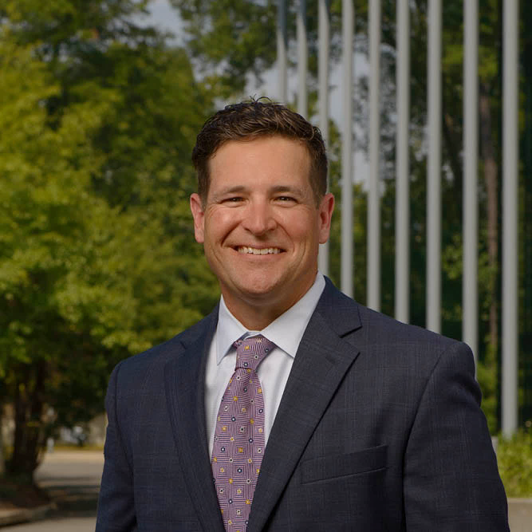
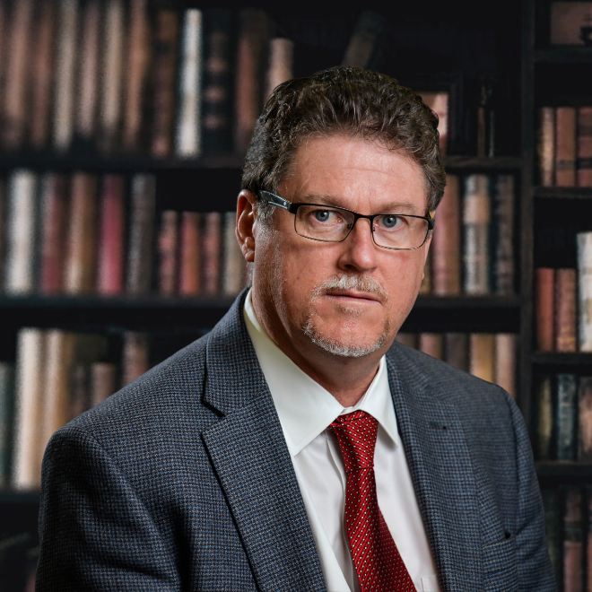
INTRODUCTION OF
NEW ACHE COMMISSIONERS
Shane Spiller
Terry Welch
President of Spiller
Associated Furniture Stores, Inc.
Chief Business Development Officer
of Contractor Service & Fabrication, Inc.

Slide 5
III. APPROVAL OF AGENDA
Commission Meeting Agenda
of March 8, 2024

Slide 6
Motion, Item III:
That the Commission accept the agenda for the March 8, 2024 meeting.

Slide 7
IV. CONSIDERATION OF MINUTES
ACHE Finance Sub-Committee Meeting Minutes of December 8, 2023

Slide 8
Motion, Item IV:
That the Commission accept the Sub-Committee Meeting minutes for the December 8, 2023 meeting.

Slide 9
V. CONSIDERATION OF MINUTES
Commission Meeting Minutes of December 8, 2023

Slide 10
Motion, Item V:
That the Commission accept the Commission Meeting minutes for the December 8, 2023 meeting.

Slide 11
VI. CHAIRMAN’S REPORT

Slide 12
VII. EXECUTIVE DIRECTOR’S REPORT

Slide 13
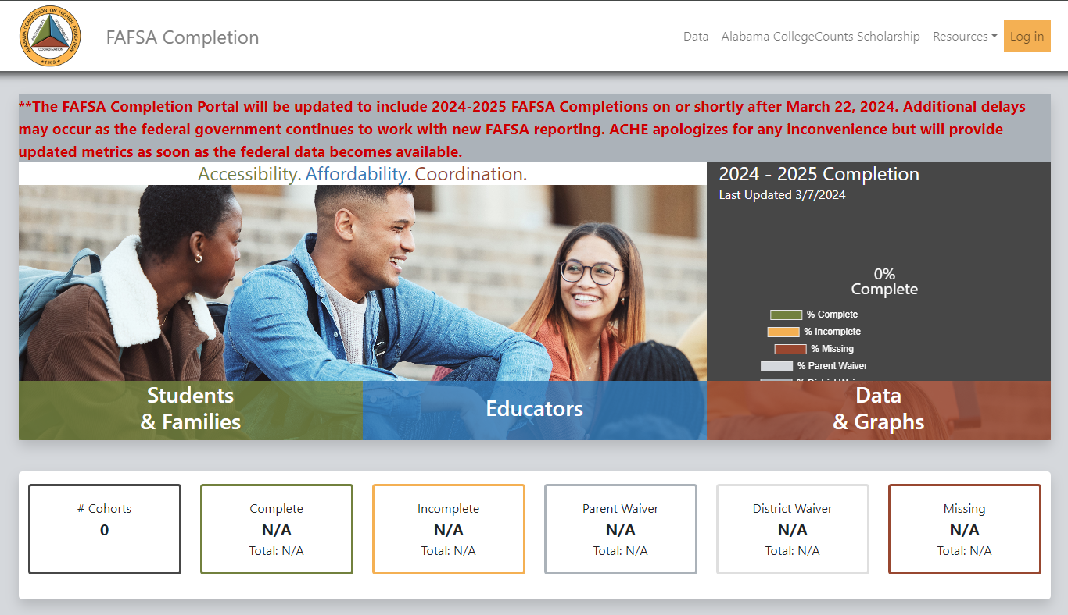
FAFSA Completion Portal Update

Slide 14
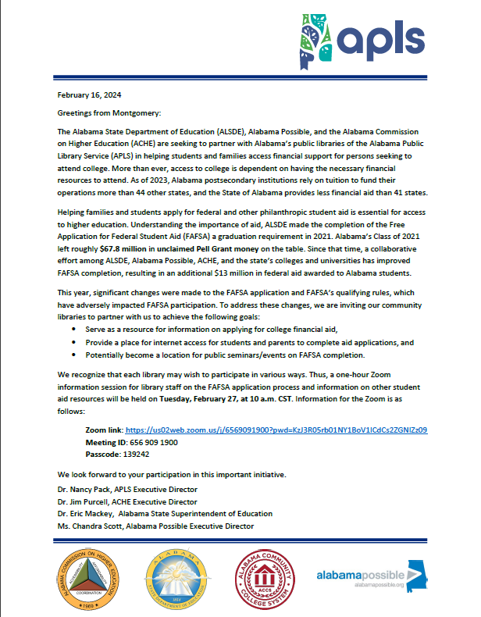

Slide 15
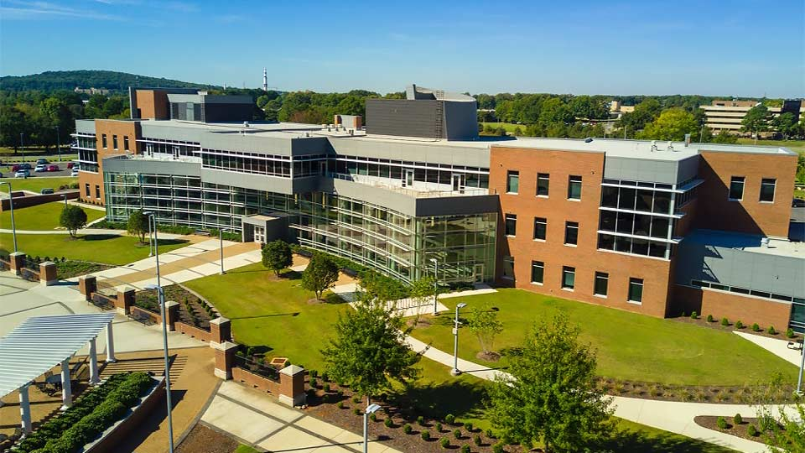
Artificial Intelligence in Alabama Higher Education Conference at UAH
On March 1, 2024, the University of Alabama in Huntsville hosted 225 university leaders, faculty, researchers, practitioners, and students from Alabama’s higher education institutions.
The conference was focused on Artificial Intelligence
in Alabama Higher Education in teaching and learning, AI-driven research and innovation, and preparing for
an AI-enabled future across key industries in Alabama.
12 sessions
45 presenters and panel guests
Keynote speaker was Dr. Ravi Pendse, Vice President for Information Technology and Chief Information Officer at the University of Michigan.

Slide 16
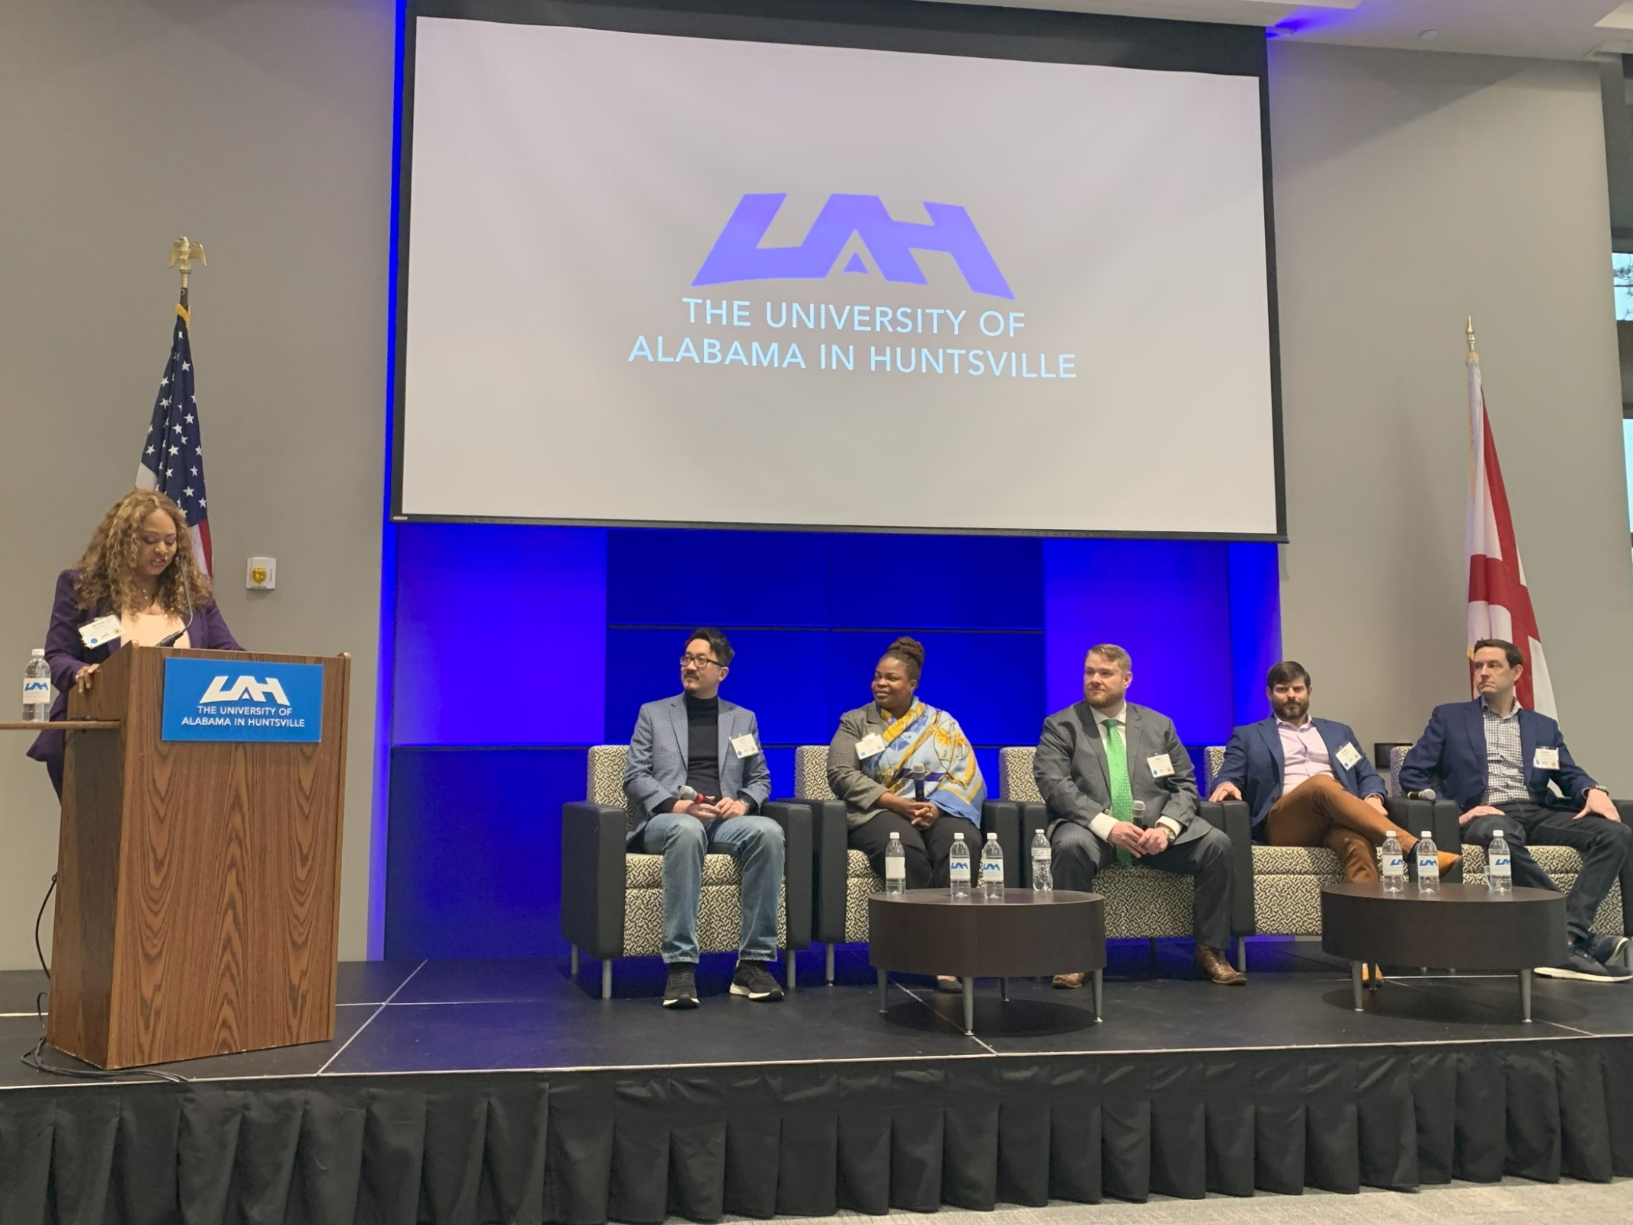

Slide 17
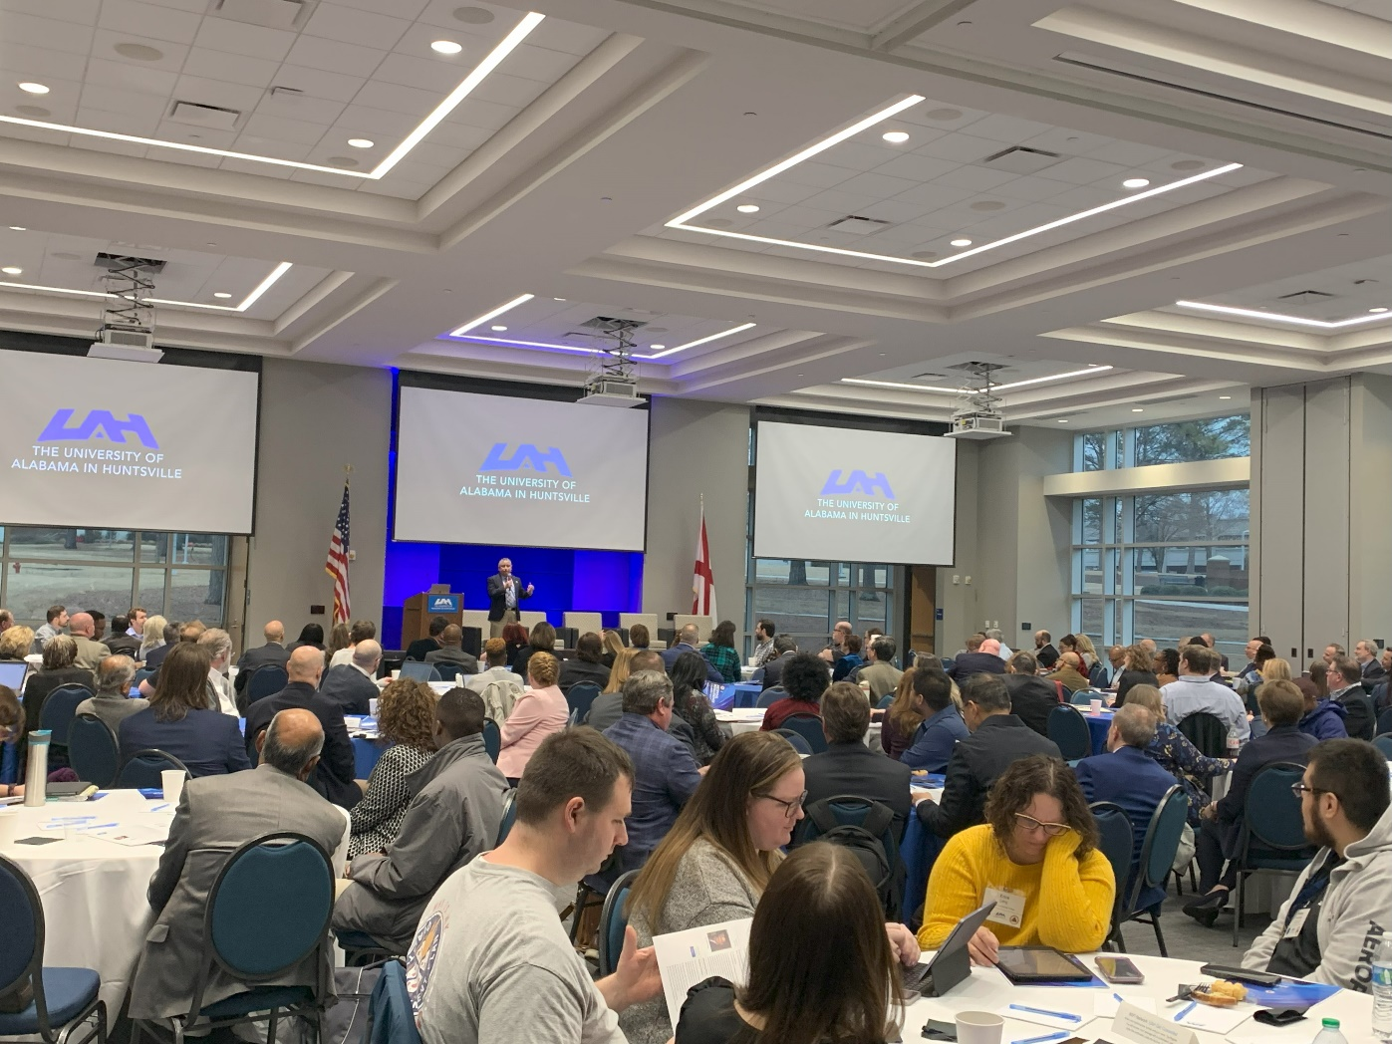

Slide 18
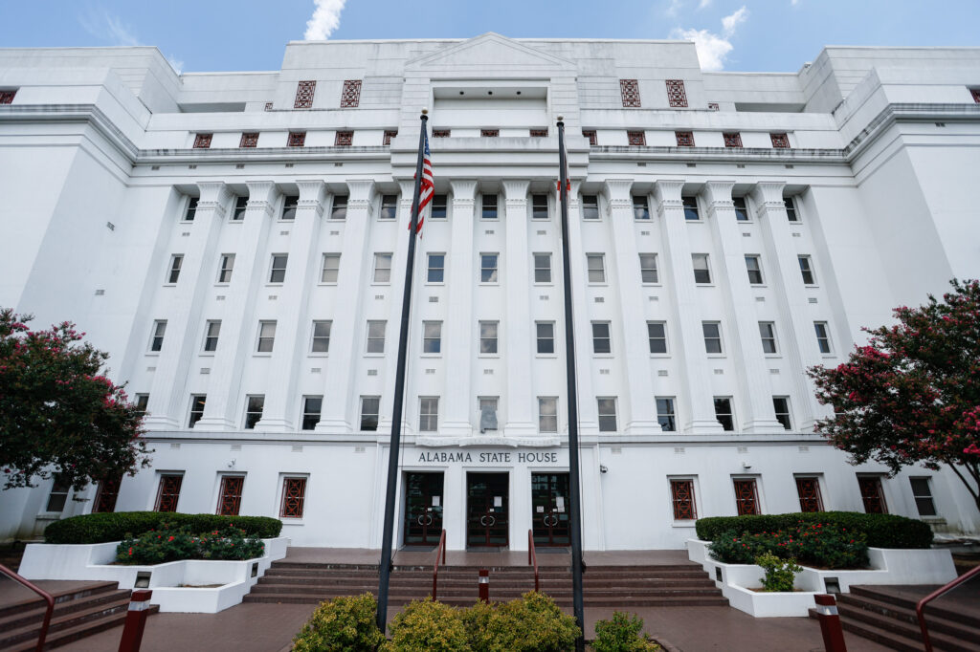
Legislative Update

Slide 19
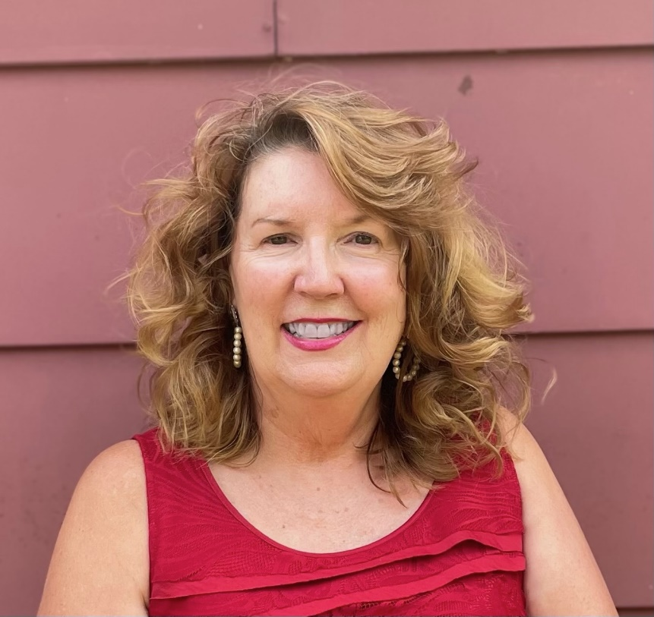
Retirement Resolution for Margaret Gunter
Margaret started at ACHE on January 7, 1999, serving at ACHE for 25 years, 1 month, and 23 days.
As Director of Communications and Governmental Relations, Margaret has worked with three Executive Directors, countless Commissioners, a myriad of legislators, and four Governors.
Her diverse expertise in media and communication along with her legislative experience have been invaluable to the work of the Commission.
ACHE wishes Margaret only the very best on her retirement!
She will be greatly missed!

Slide 21
Legislative Update
HB145 – First Look at 2025 Funding for Education
Makes appropriations for the support, maintenance, and development of public education in Alabama, for debt service, and for capital outlay for the fiscal year ending 9/30/2025.
The Timeline
ACHE Budget Hearings for institutions and systems – November
Consolidated Budget Recommendation for Higher Education – December ACHE
Joint House and Senate Education Trust Fund (ETF) hearing
Governor’s Recommendation for all of state government – start of the session
Time to speak to legislators about budget needs not addressed in Governor’s Budget
House ETF Budget
Senate ETF Budget vote
Potentially Conference Committee
The Governor cannot introduce a bill. The Chair of the House or Senate Money Committee introduces it to lawmakers. The budget starts in the House this year.

Slide 22
Supplemental 23
(ONE-TIME)
$35,270,000
ETF 25
(Re)Engage Scholarship | $5,000,000
Alabama National Guard | $3,400,000
Alabama National Guard | $3,400,000
(Re)Engage Scholarship | $4,500,000
Deferred Maintenance | Maintained 5M of 10M
Supplemental
24
Best and Brightest | $270,000
{
Deferred Maintenance | $5,000,000 $5,000,000
Outcomes Based Funding | $15,000,000

Slide 23
Legislative Update
HB144 – Supplemental Appropriation
This bill will make supplemental appropriations from the Education Trust Fund to specified agencies for FY2024.
Smaller than prior year supplemental bills
HB146 – Salary Increase
This bill will increase salaries for public education employees, including K-12, postsecondary education, and AIDB by 2%.
Authorizes 2% COLA raises for state employees, including ACHE O&M staff

Slide 24
Legislative Update
HB151 and HB152 – Gaming
This bill will establish and provide for a last-dollar postsecondary scholarship program for public two-year community and technical colleges to provide degrees, certifications, course credit, and credentials for in-demand fields to meet instructional and workforce training needs throughout the state.
This bill will in support of dual enrollment costs at any public two-year or four-year university in the state.
This bill will make funding provisions for four-year colleges for research purposes.

Slide 25
Legislative Update
HB147 – Education Trust Fund Advancement and Technology Appropriation
This bill makes supplemental appropriations from the Education Trust Fund Advancement and Technology Fund for FY2024, including appropriations to the public institutions of higher education in the amount of $191,590,000.
Universities and Community Colleges split these funds according to a formula
Can use for technology and deferred maintenance, safety issues
SB129 – Diversity, Equity, Inclusion (DEI)
The bill proposes new measures that would prohibit state agencies, education boards, and public institutions from engaging in DEI programming.
Seeks to eliminate “divisive concepts” that could promote division on the grounds of race, class, sexuality, or national origin
Generated considerable public interest
Recently passed the Senate and House
Awaiting the Governor’s signature

Slide 26
Legislative Update
SB31 – Distressed Institutions
Changes the administrator of the Distressed Institutions of Higher Education Revolving Loan Program to the Executive Director of the Alabama Commission on Higher Education.
Amends last year’s bill
Replaces the State Treasurer with ACHE Executive Director
Changes criteria for approval for a loan
After receipt of application, ACHE will have 30 days for making a payment.
Received a favorable report from the Senate F&TE Committee
Passed the Senate
Now goes to a House Committee for consideration

Slide 27
Legislative Update
SB100 – Board of Medical Scholarship Awards Fund
Creates the Board of Medical Scholarship Awards Fund in the State Treasury, requires funds received by the board from the repayment of loans, fees, donations, grants, and bequests to be deposited in the fund for granting scholarships and making loans to medical students.
Senate passed
Received a favorable report from the House Ways & Means Committee
SB55 – State Personnel Job Classifications
Would require the State Personnel Director to regularly assess the requirements for employment within classifications of positions in the state service and identify classifications for which the requirements may be reduced.
Some may change the requirement of a four-year college degree
Senate passed
Received a favorable report from the House State Government Committee but has yet to be on the House floor

Slide 28
Legislative Update
SB176 – Alabama Career Roadmap
Would require the Alabama Community College System to develop a workforce exploration module, completion of which would be required for a student to graduate high school.
Assigned to Senate Education Policy Committee
HB210 – Education of Unlawfully Present Aliens
This bill will allow aliens not lawfully present in the United States who have attended high school for more than three years and graduated from HS in this state to attend public postsecondary education institutions in this state.
Assigned to the House Education Policy Committee
SB169 – Extension on Educational Benefits for Veterans
This bill extends educational benefits for eligible dependents of deceased or disabled veterans to include post-bachelor and graduate studies in a medical field.
Assigned to the Senate F&TE Committee

Slide 29
Legislative Update
SB183 – Closed Browser Remote Testing
This bill would authorize the closed browser remote testing of full-time virtual students for state required assessments under certain conditions. This bill would also specify the conditions for administering the assessments and would exempt public institutions of higher education.
Assigned to the Senate Education Policy Committee
Received a favorable report from the Senate Education Policy Committee
SB189 – Tuskegee University Appropriation for Match Funding
This bill would require appropriations from the ETF to Tuskegee University for FY2025 through FY2035 to compensate the university for the lack of match funding needed for federal formula funding made available to land-grant universities from 1987 through 2020.
Assigned to the Senate F&TE Committee

Slide 30
VIII. DISCUSSION ITEMS

Slide 31
Update on Student Horizon Database
Staff Presenter: Dr. Jim Hood

Slide 32
Student Horizon Database
ACT 2023-556
Students’ Right to Know Act
…to require the Alabama Commission on Higher Education to collect data and create an interactive online tool for students for use in making informed decisions about their education and professional future.

Slide 33
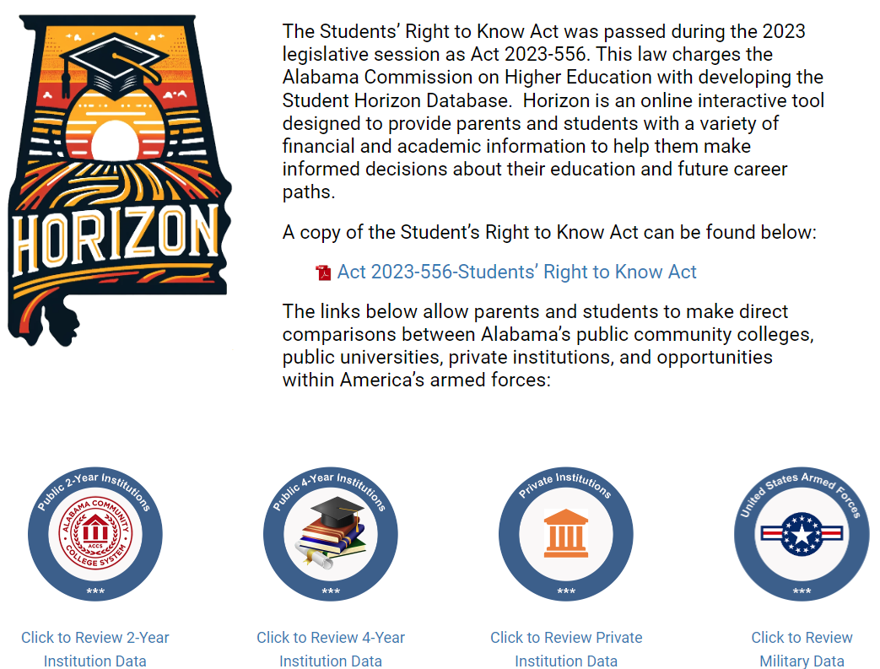
Horizon Landing Page
Link to the Legislation
Separate links to institutional data and military information

Slide 35
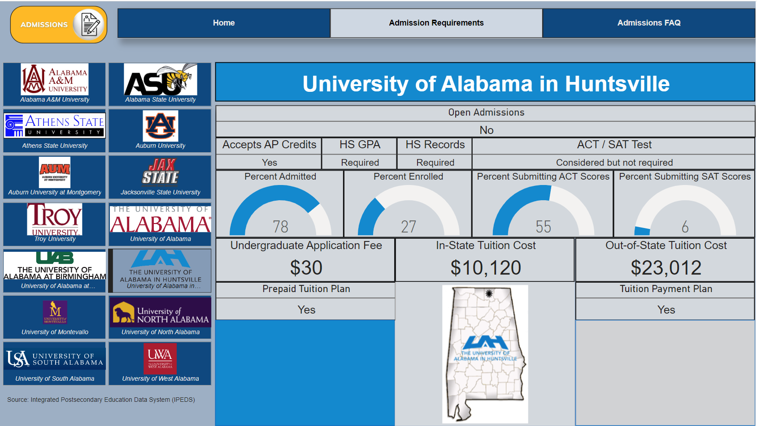

Slide 36
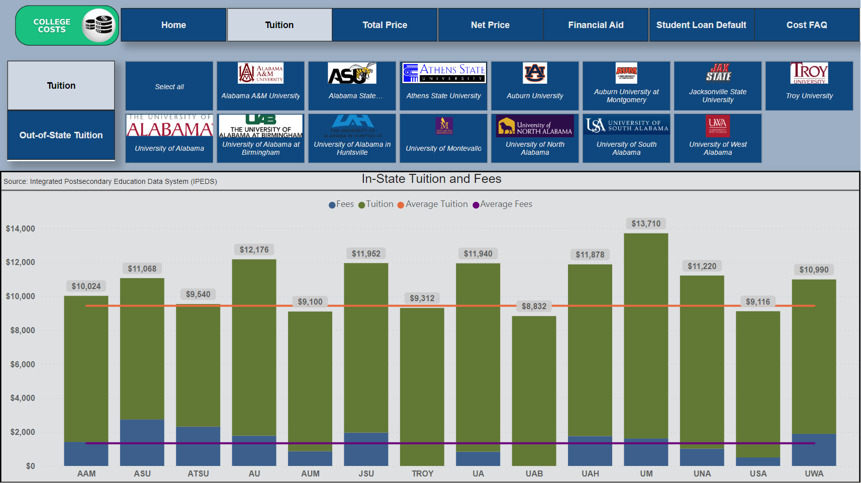

Slide 37
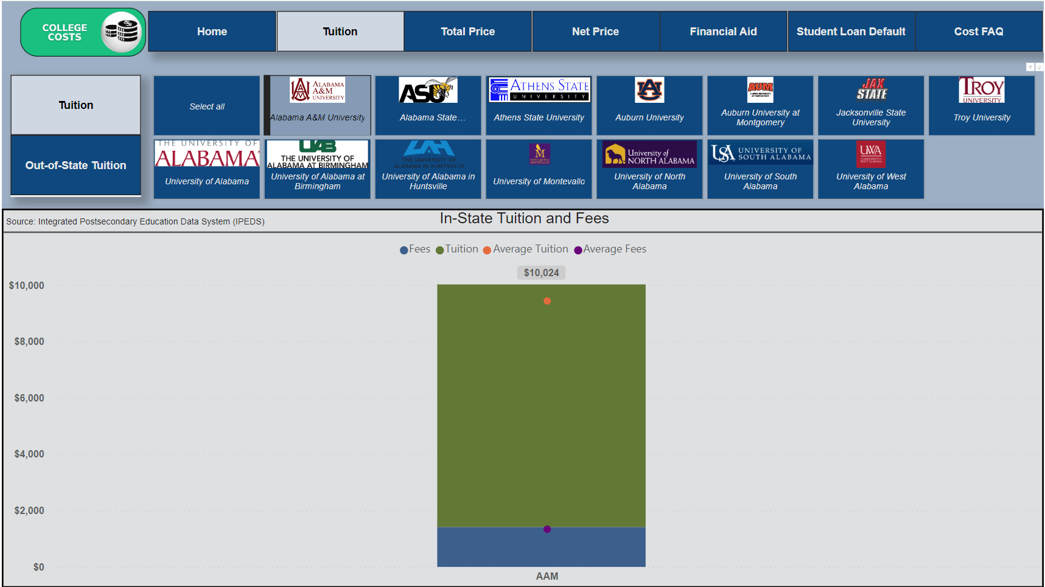

Slide 39
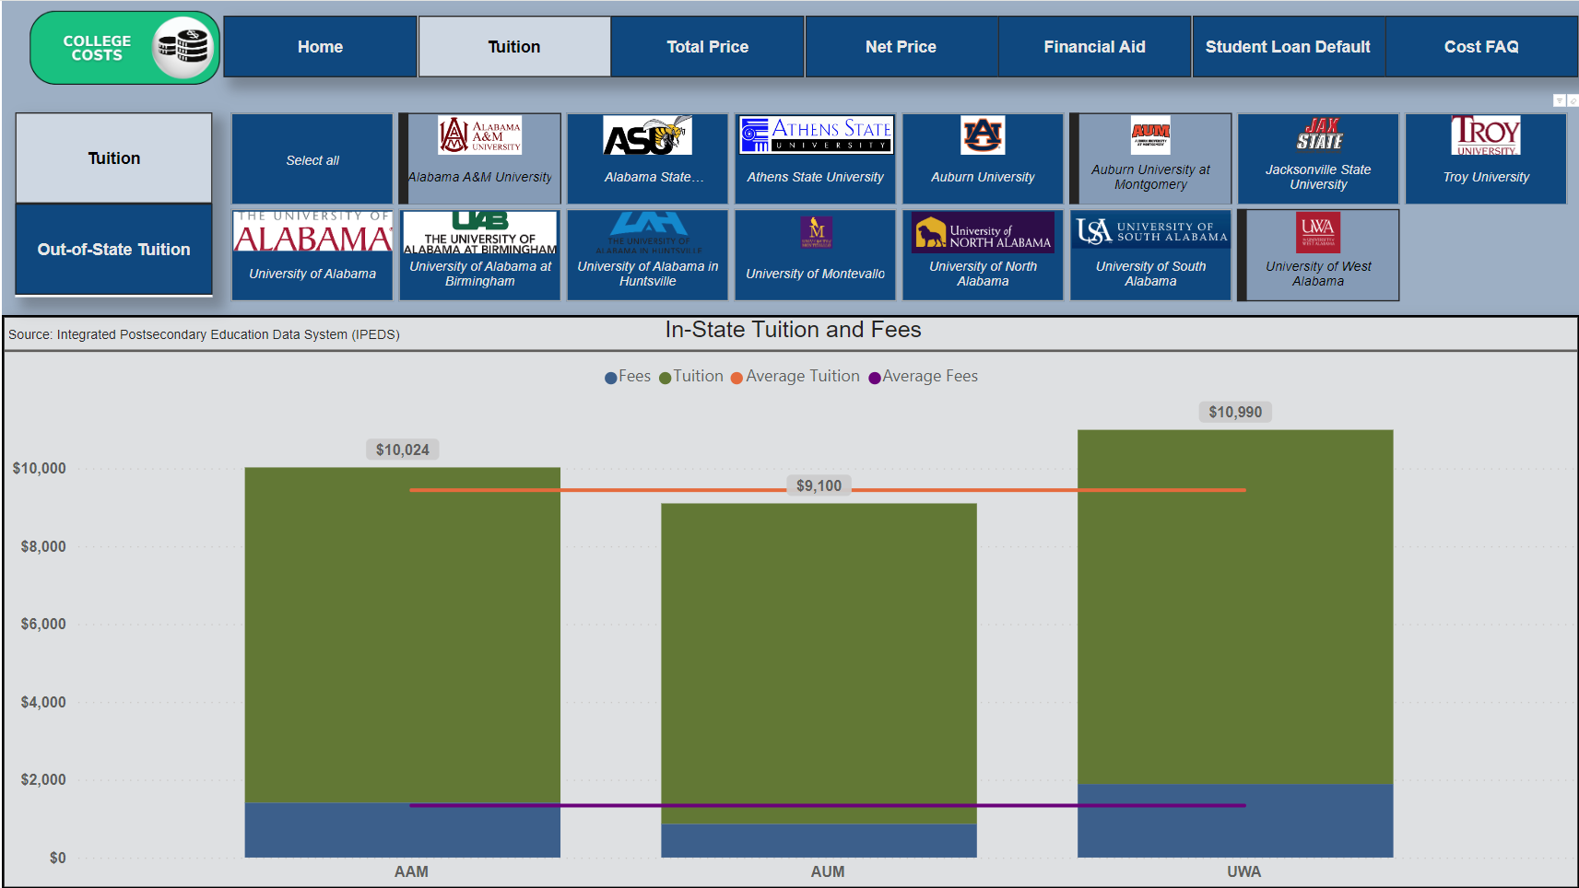

Slide 40
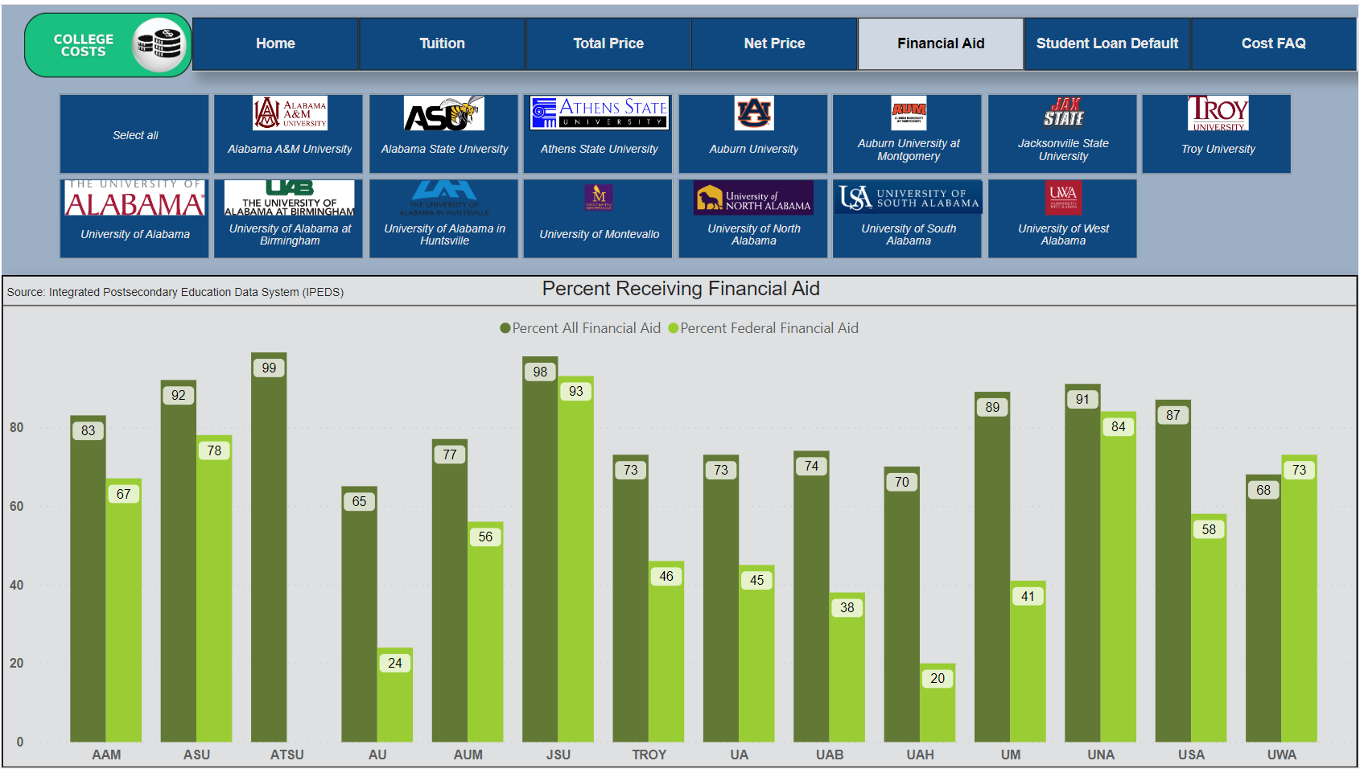

Slide 42
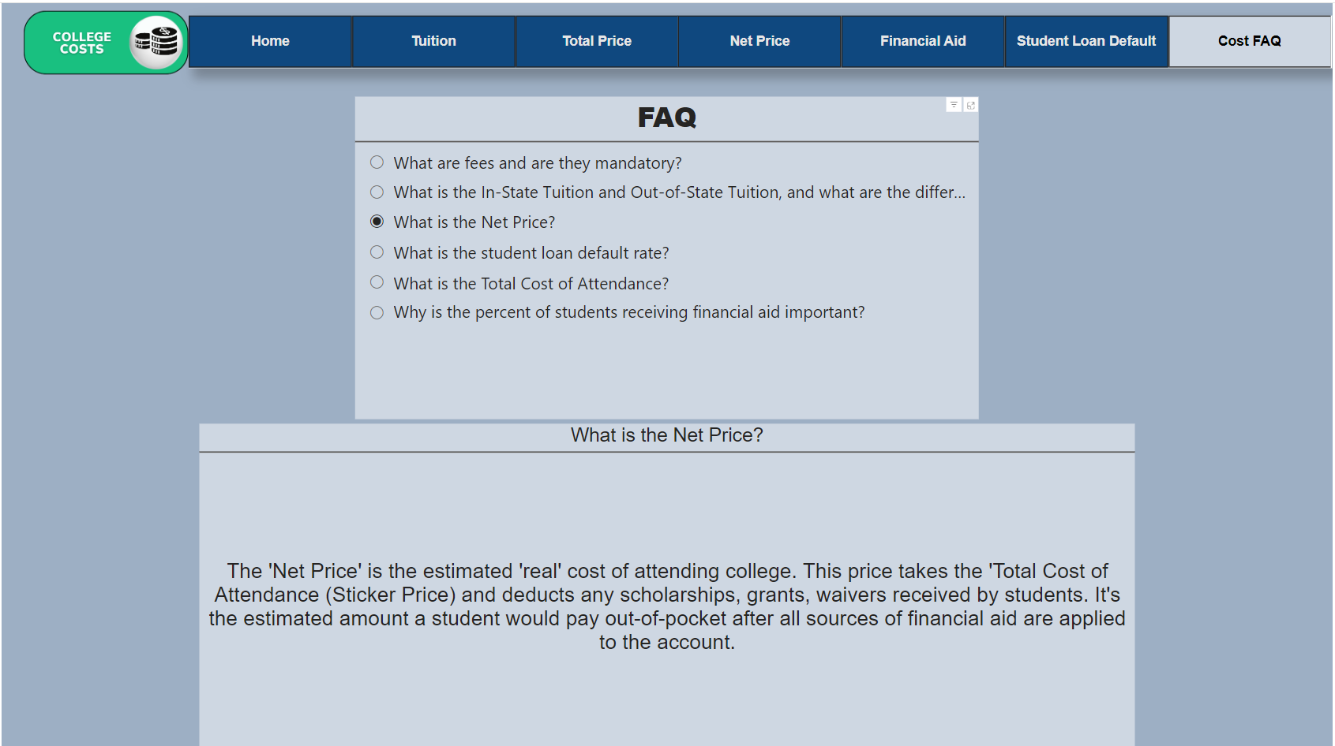

Slide 45
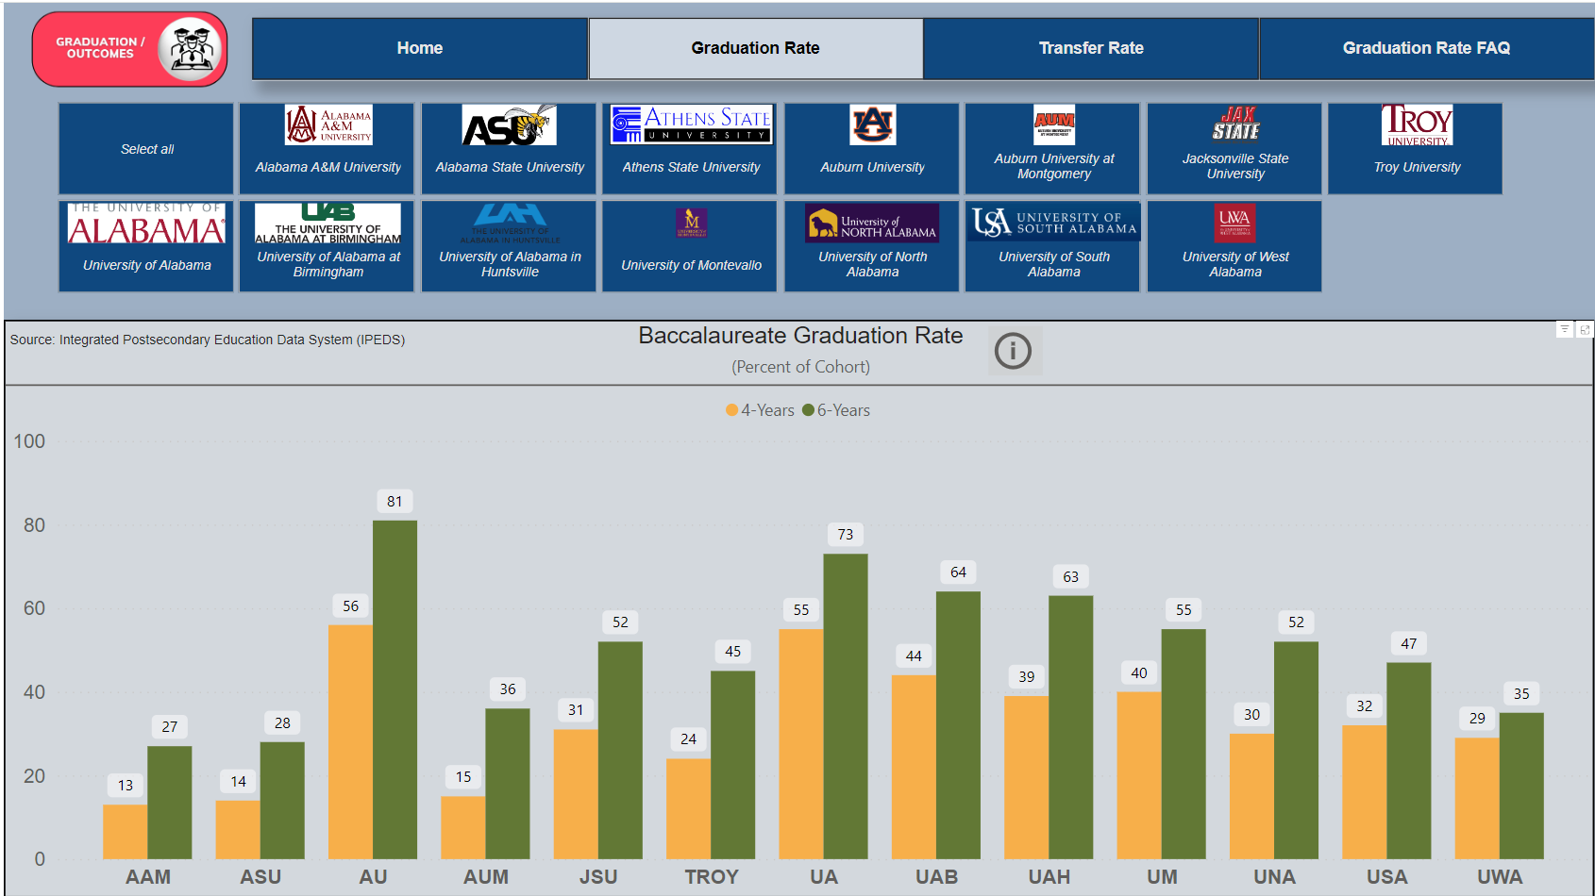

Slide 46
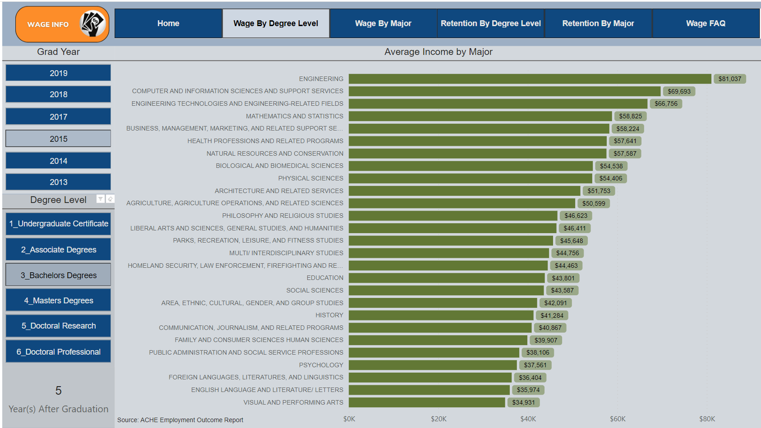

Slide 47
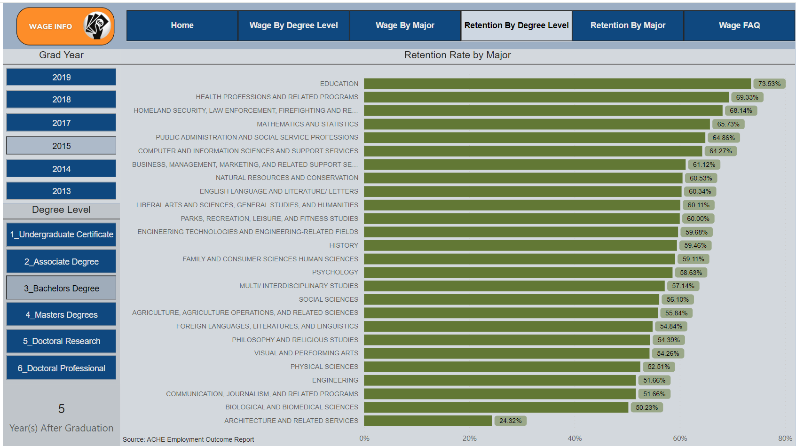

Slide 49
Student Horizon Database Next Steps
Finalize data metrics and definitions
Update metrics with latest federal IPEDS data
Share with institutions for feedback and data verification
Finalize Student Horizon Database for public use
Promote access through press releases and social media

Slide 50
UTeach STEM Teacher Recruitment
Presenters:
Dr. Lee Meadows and Lawrence Cooper
Combatting Alabama’s STEM Teacher Shortage!

Slide 51
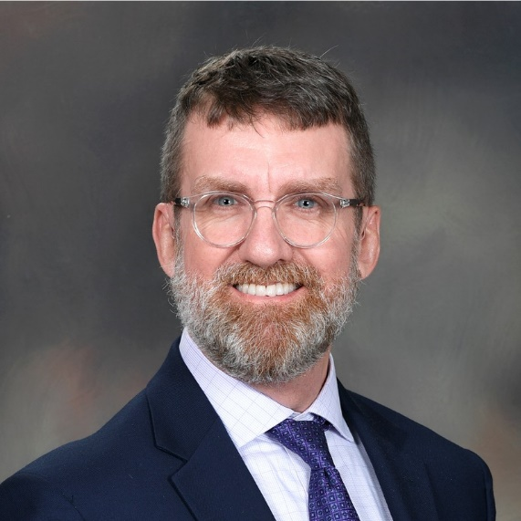
Dr. Lee Meadows
Executive Director
Lee Meadows, Ph.D., is a science educator and the Executive Director of the Alabama STEM Council, where his work focuses on building the STEM education system Alabama needs for a thriving STEM workforce.
A teacher at heart, he has taught high school chemistry, physics, and physical science; college chemistry; and many teacher education courses, especially science teaching methods.
He spent most of his career as a professor in the School of Education at the University of Alabama at Birmingham, guiding teachers to improve their practice especially with better skills for inquiry and implementing science and engineering practices. He also led the implementation of UABTeach, Alabama’s first UTeach implementation site.

Slide 52
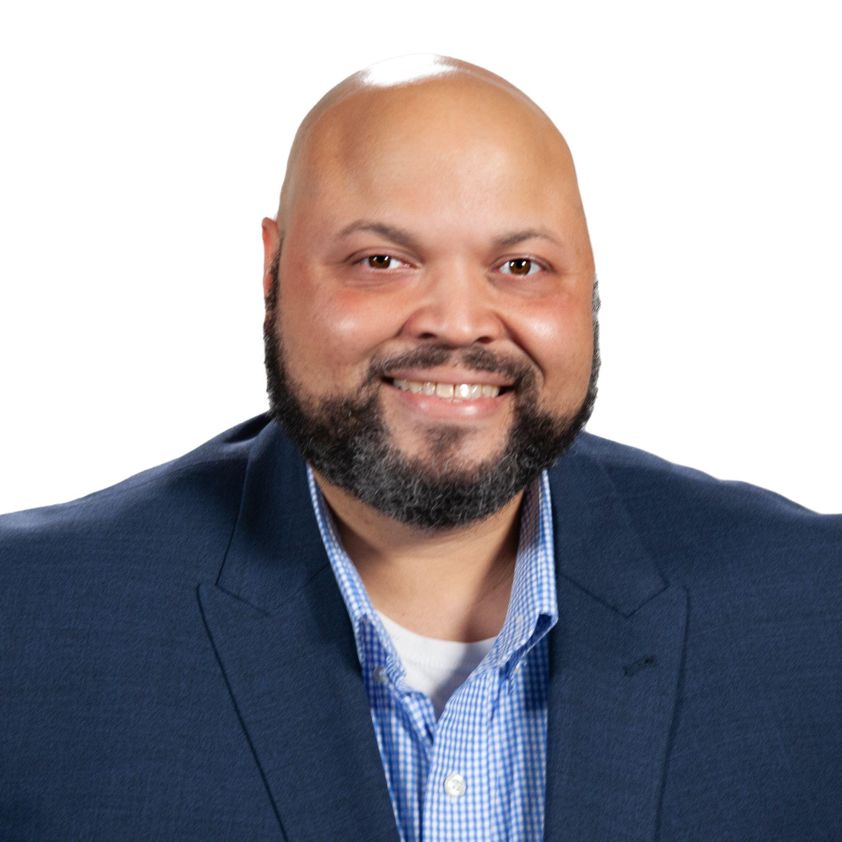
Lawrence Cooper
STEM Programs Manager
Lawrence Cooper is an experienced STEM education professional with over 20 years of demonstrated success in managing and leading STEM education opportunities.
Prior to joining the STEM Council Operations Team, he has directed a variety of programs, including a state-wide outreach program, educator professional development,K-12 learning experiences and community-based projects. He previously served as the Senior Director of Science Education at the McWane Science Center.
As a part of the STEM Council Operations team, he manages key initiatives, including the STEM Teacher Externship Program, Scale Up and STEM Near Me directory.

Slide 54
“Alabama is taking the lead in ending the shortage of STEM teachers! With UTeach Alabama, we are implementing a proven solution that will give Alabama schools the teachers they need to prepare the next generation of STEM learners.”
– Governor Kay Ivey

Slide 55
UTeach Alabama- New STEM Teacher Preparation programs
University | Program Name | Location | Amount Awarded*
Alabama A&M Univerity | AAMUTeach | Huntsville | $2 million
Athens State University | Athens State Teach | Athens | $2 million
Auburn University | AUTeach | Auburn | $3 million
Auburn University at Montgomery | AUMTeach | Montgomery | $2 million
University of South Alabama | Uteach South | Mobile | $2 million
University of West Alabama | UWA-Teach | Livingstone | $3 million
*assuming level funding over 5 years
Notes:
Under this initiative UABTeach is receiving 450K per year in support

Slide 56
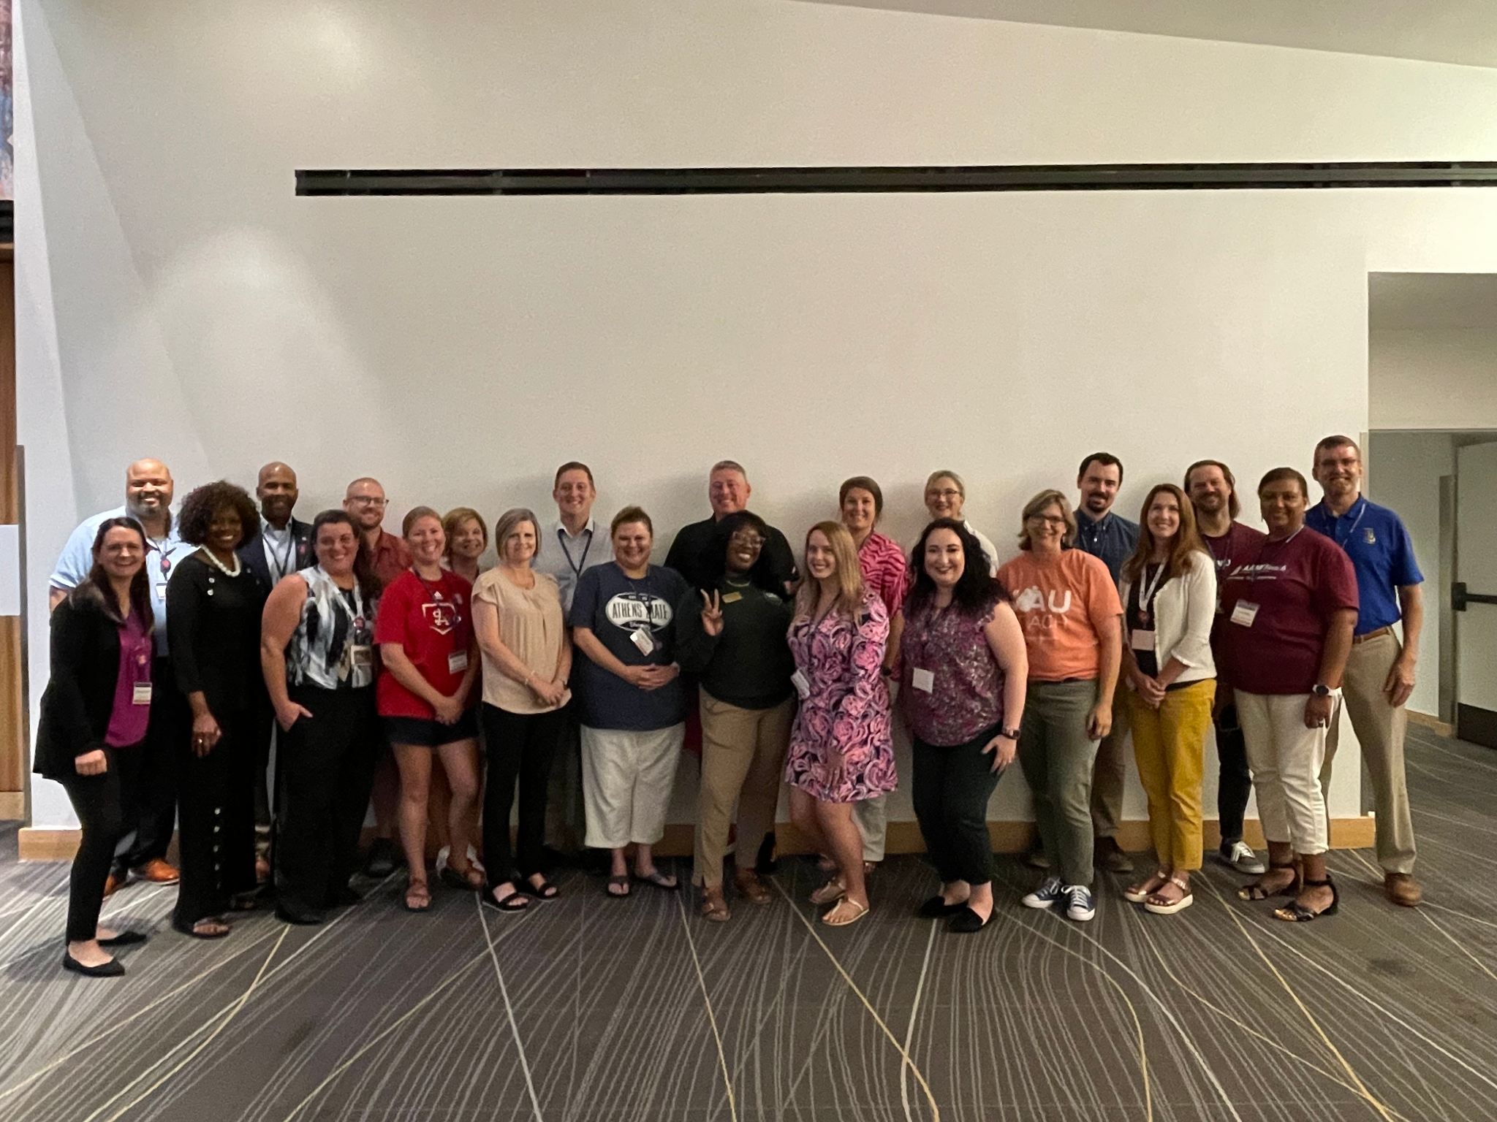
UTeach in Alabama site representatives at
the 2023 UTeach STEM Educators Conference

Slide 57
Key Staff: Co-Directors
UTeach Alabama Site | Co-Directors
Alabama A&M University (AAMUTeach) | Dr. Nathan Blom Dr. Vernessa Edwards
Athens State University (Athens State Teach) | Dr. Patricia Glaze Dr. Leigh Hester
Auburn University (AUTeach) | Dr. Christine Schnika Dr. Stephanie Shepherd
Auburn University at Montgomery (AUMTeach) | Dr. Samantha Junkin Dr. Quintavius Rover
University of Alabama at Birmingham (UABTeach) | Dr. Paulette Evans
University of South Alabama (UTeach South) | Dr. Christopher Parrish Dr. Kelly Major
University of West Alabama (UWA-Teach) | Dr. Tracy Keener Dr. Jerri Ward-Jackson

Slide 58
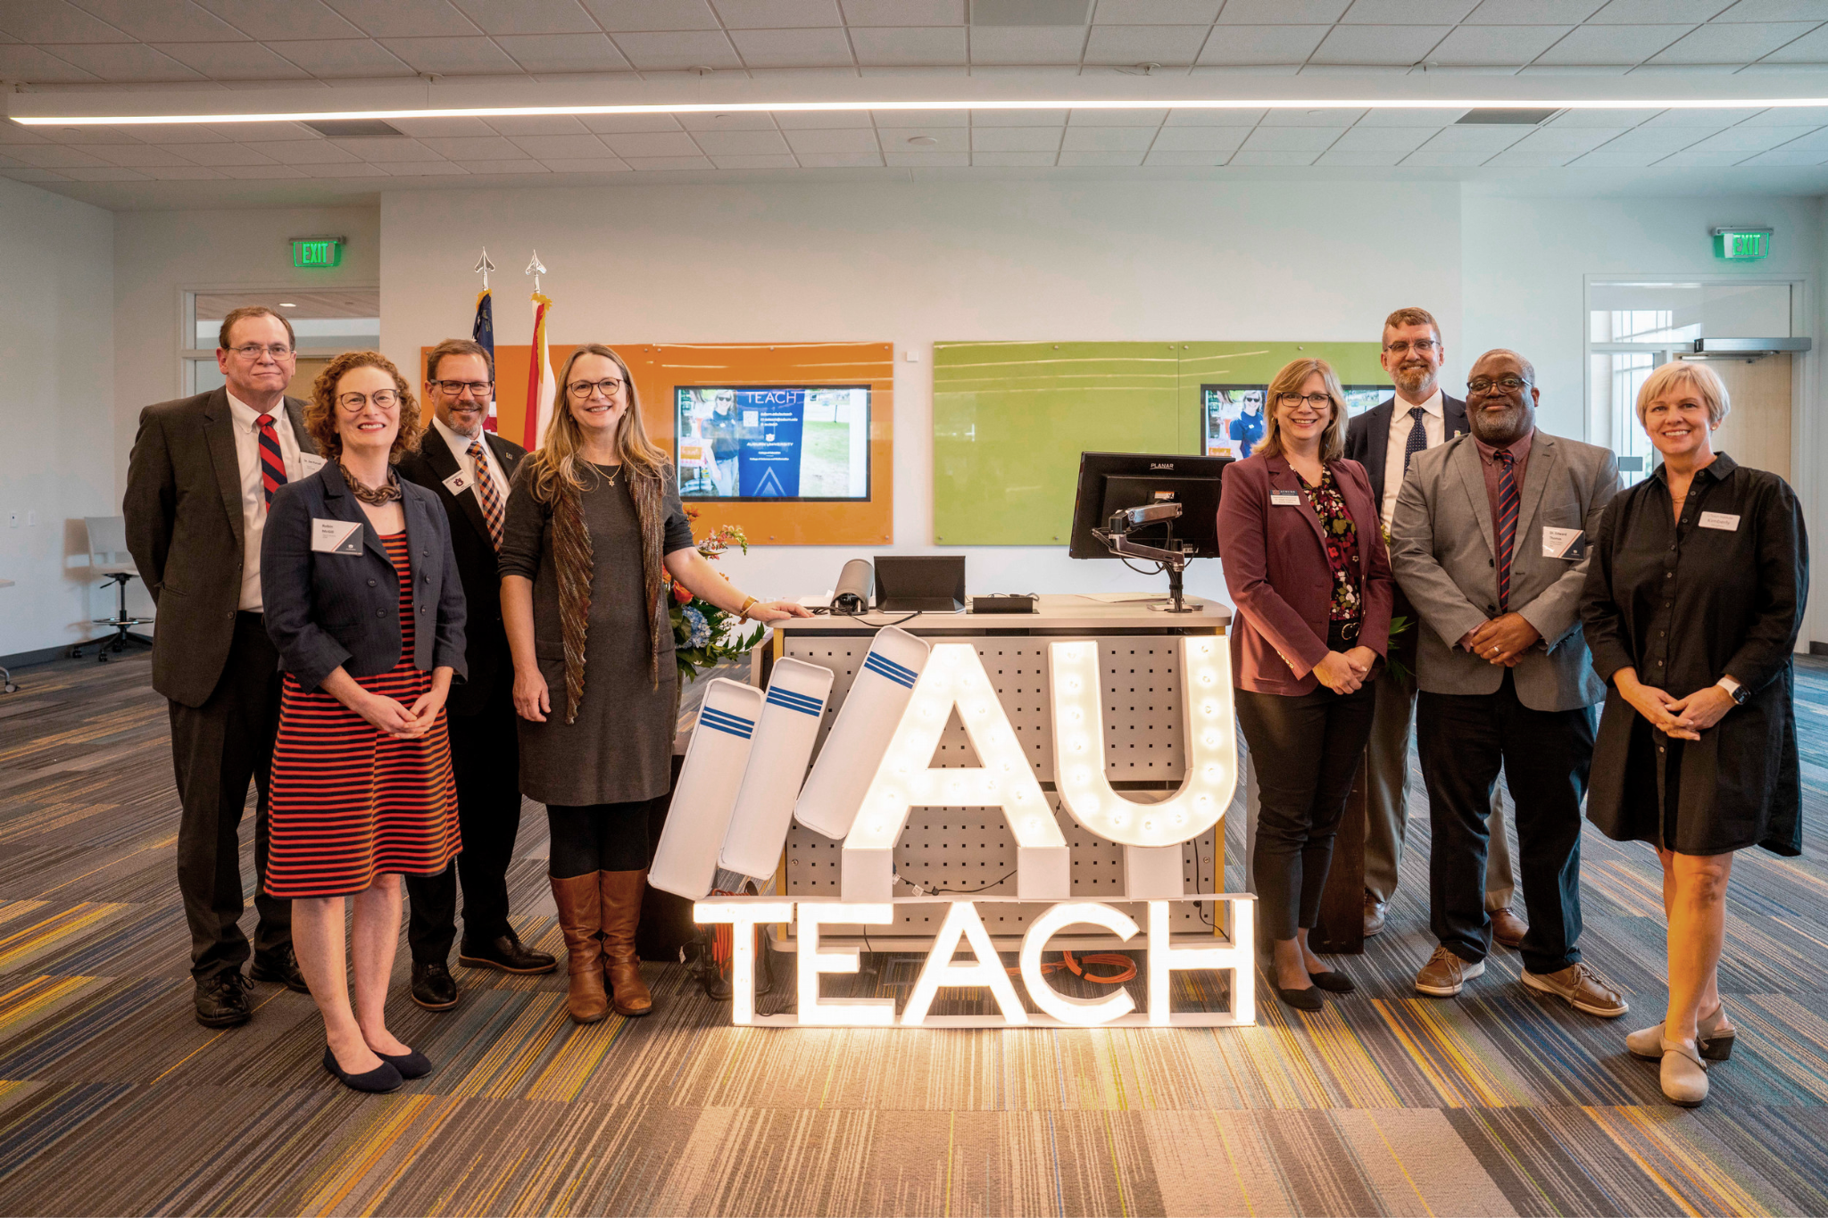
Planning/Implementation Milestones
Program Launch Support & Site Visits
Collaboration Across Colleges
Assembling Program Teams
Identifying Program Space

Slide 59
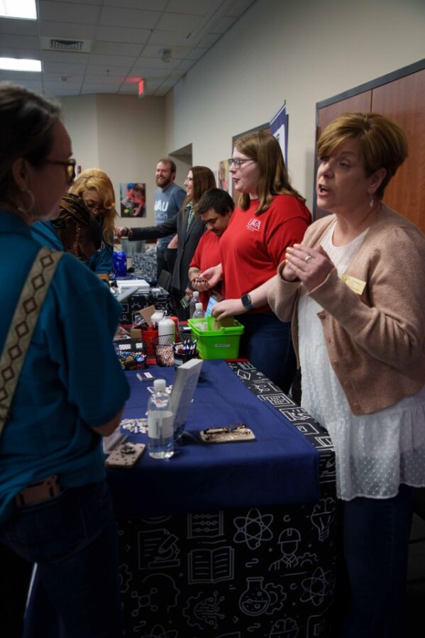
Planning/Implementation Milestones
Supporting and Recruiting Students
Designing Courses and Instructional Programming
Creating Identity on Campus

Slide 60
UTeach Alabama Enrollment in Exploratory Courses
University | Program Name | Fall 2023 New Students | Spring 2024 New Students | Year 1 New Students
Alabama A&M Univerity | AAMUteach | 37 | 16 | 53
Athens State University | Athens State Teach | 12 | 6 | 18
Auburn University | AUTeach | 16 | 26 | 42
Auburn University at Montgomery | AUMTeach | 32 | 11 | 43
University of South Alabama | UTeach South | 22 | 28 | 50
University of West Alabama | UWA-Teach | 11 | 12 | 23
TOTALS |  | 130 | 99 | 229
University of Alabama at Birmingham | UABTeach | 119 | 44 | 163
TOTALS with UABTeach |  | 249 | 143 | 392
Notes:
*Please note that UABTeach is an established program and these numbers reflect enrollment for Y1 of the Alabama UTeach Initiative, NOT current total program enrollment.
A&M’s fall Step 1 course is an orientation option, few students do orientation in spring

Slide 61
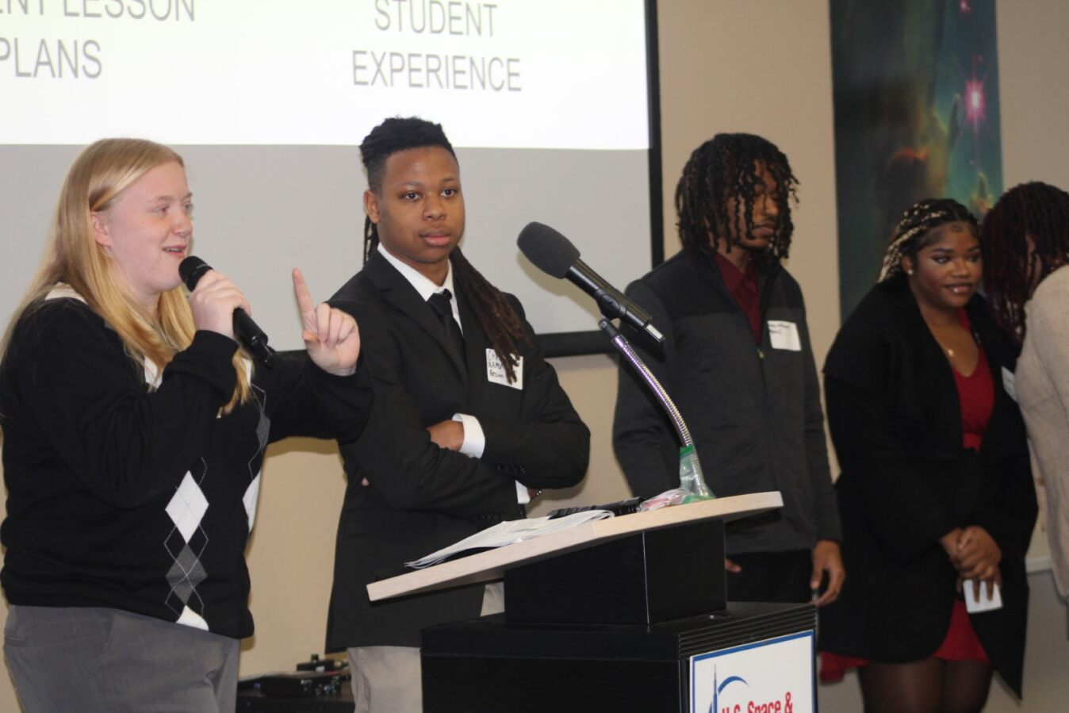
Innovative Status Update
Created a UTeach Alabama Innovative Status application template
Application Review Complete
ALSDE Working Group (February 7)
ALSDE Board Meeting (March 14)

Slide 62
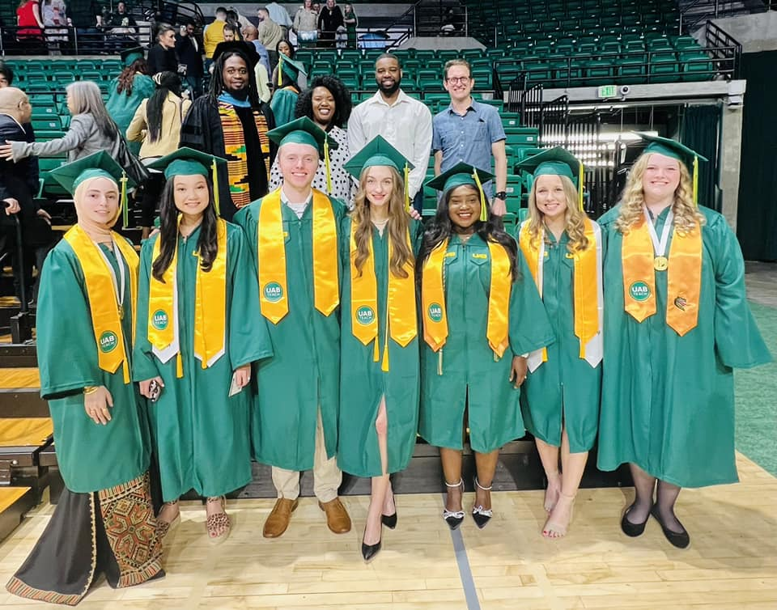
Upcoming Activities
Fall site visit report submission (March)
Spring site visits (March-April)
UTeach Conference (May 21-23)
2023-24 Combined report (Summer)
Launch of Sophomore Level Courses

Slide 63
Thank You!

Slide 64
IX. Decision ITEMS

Slide 65
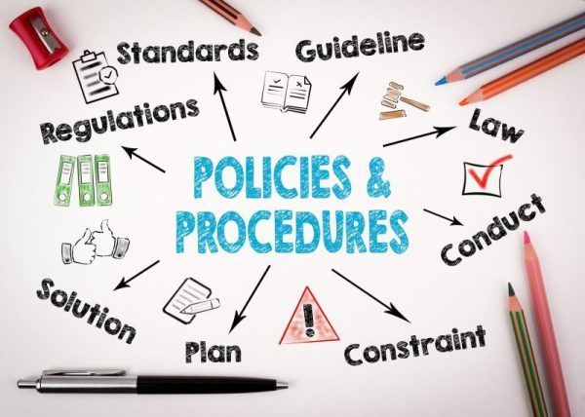
Final Approval of Repeal and New Rule §300-2-1-.06 (Extensions and Alterations) within Administrative
Procedures for Academic Program Review
Staff Presenter: Dr. Robin McGill

Slide 66
Final Approval of *New Rule* §300-2-1-.06
300-2-1-.06 Reasonable Extensions and Alterations of Existing Programs of Instruction
Last Amended: 2018
Synopsis of Section: This section describes extensions and alterations to instructional units and academic programs, including changes to the academic program inventory, addition of program options, and establishment of non-degree certificates. Before the 2018 amendment, this section required Commission approval for nearly all extensions and alterations. Under the amended version, many changes only require notification to the Commission.
Summary of Recommended Changes:
References to units of instruction will no longer be included, as they are treated in §300-2-1-.11.
Needs to include a clear statement of purpose, Commission responsibility, and scope, along with relevant definitions, especially for For-Credit Non-Degree Certificates.
Subsections need to be substantially reorganized to improve clarity and better align with SACSCOC Substantive Change requirements.
Obsolete provisions need to be eliminated.
Summary of Stakeholder Discussions:
5 open forum sessions held with institutional stakeholders over the past year.
Academic Affairs Committee reviewed on November 28, 2023, and unanimously recommended approval.
Commission reviewed on December 8, 2023, and unanimously recommended approval.

Slide 67
Organizational Structure for
Final *New Rule* §300-2-1-.06
Reasonable Extensions/Alterations of Existing Programs
Changes to Degrees
(IPEDS Levels 2, 3, 5, 7, 17,18,19 + EdS)
Changes to For-Credit, Non-Degree Certificates
(IPEDS Levels 1a, 1b, 6, 8)
Substantive, requiring notification
➔ Title change
➔ CIP change
➔ Nomenclature change, excl doctoral
➔ Modality change 100%
➔ Curriculum updates 25%< change < 49%
➔ Addition of options
Substantive, requiring approval
➔ Split existing program into two
➔ Merge existing degree programs into one
➔ Doctoral programs-- nomenclature and level
➔ Prog changes >50%
➔ Prog Length change by 25%
Non-substantive changes (do not require ACHE notification)
➔ Course updates ➔ Minors ➔ prg changes <%25 ➔modality, unless 100% change
Substantive, requiring notification
➔ Addition of new certs
➔ Deletion of certs
➔ CIP changes to certs
➔ IPEDS level change
➔ Modality change 100%
Non-substantive (do not require ACHE notification)
➔ Course updates
➔ Most delivery modality change
➔ Title change w/o content change
Substantive, requiring approval
➔ Split existing program into two
➔ Merge existing degree programs into one
➔ Doctoral programs-- nomenclature and level
➔ Prog changes >50%
➔ Prog Length change by >25%
Non-substantive changes
(do not require ACHE notification)
Course updates
Minors
Prog changes <%25
Modality, unless 100% change

Slide 68
Motion, Decision Item A
That the Commission give final approval to the Repeal and New Rule §300-2-1-.06 (Extensions and Alterations) within Administrative Procedures for Academic Program Review.

Slide 69
B. Academic Programs
Staff Presenters: Dr. Robin McGill
and Ms. Kristan White

Slide 70
FOUR-YEAR INSTITUTIONS

Slide 71
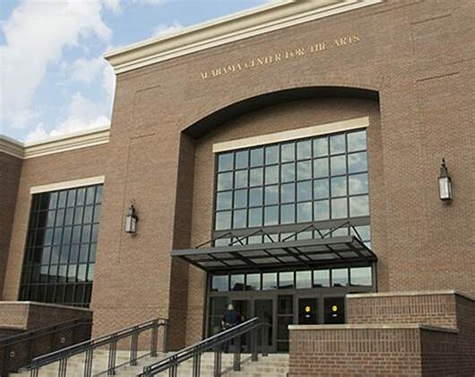
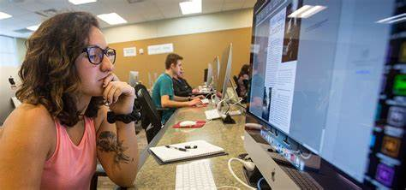
Athens State University
1. Bachelor of Fine Arts in Theatre (CIP 50.0501)
The proposed program will build upon and replace the existing BA in Drama and Theatre Arts and therefore will require minimal new resources to deliver.
The program will be delivered at the Alabama Center for the Arts in Decatur, a state-of-the-art facility that offers approximately 45,000 square feet of performing arts space, in partnership with Calhoun Community College.

Slide 72
Motion, Decision Item B-1:
That the Commission approve Athens State University’s proposal to offer a Bachelor of Fine Arts in Theatre.

Slide 73
Auburn University
2. Master of Science in Artificial Intelligence Engineering (CIP 11.0102)
Over the past few years, jobs in artificial intelligence and machine learning have jumped by almost 75%, and the proposed program will help fill the need for artificial intelligence experts.
The proposed program will take advantage of substantial strengths that already exist in Auburn’s College of Engineering, Department of Computer Science and Software Engineering and will require no new resources to implement.
This Photo by Unknown Author is licensed under CC BY-ND

Slide 74
Motion, Decision Item B-2:
That the Commission approve Auburn University’s proposal to offer a Master of Science in Artificial Intelligence Engineering.

Slide 75
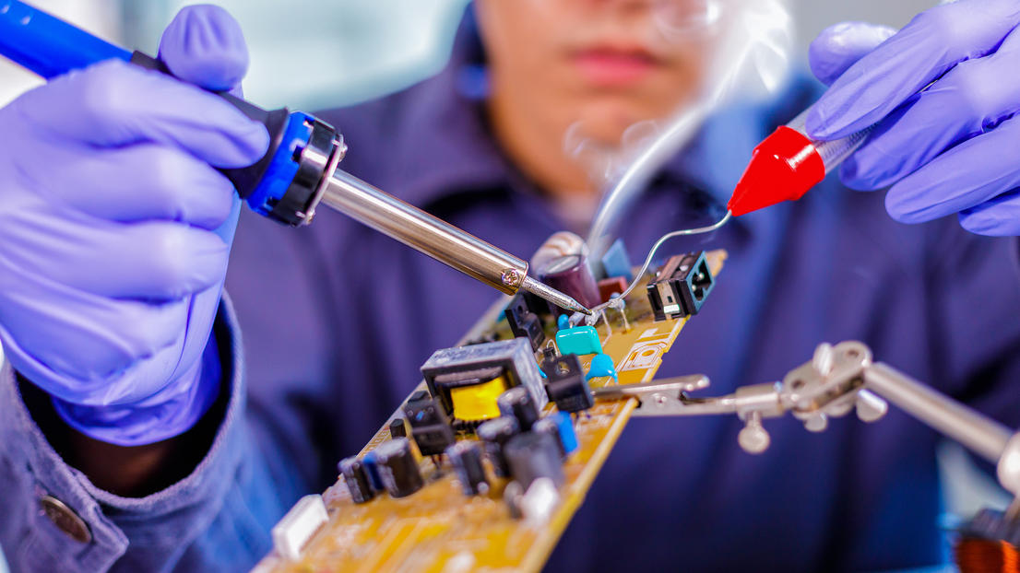
University of West Alabama
3a. Bachelor of Science in Electrical Engineering Technology (CIP 15.0303)
The proposed BS in Electrical Engineering Technology will provide a more specialized curriculum than current BS in Engineering Technology (CIP 15.0000) in response to industry need.
The proposed program will utilize existing faculty and resources within UWA’s Division of Engineering and Technology to reduce start-up costs.
The proposal is accompanied by fourteen letters of support from UWA’s Industrial Advisory Board members, who represent potential employers.

Slide 76
Motion, Decision Item B-3a:
That the Commission approve University of West Alabama’s proposal to offer a Bachelor of Science in Electrical Engineering Technology.

Slide 77
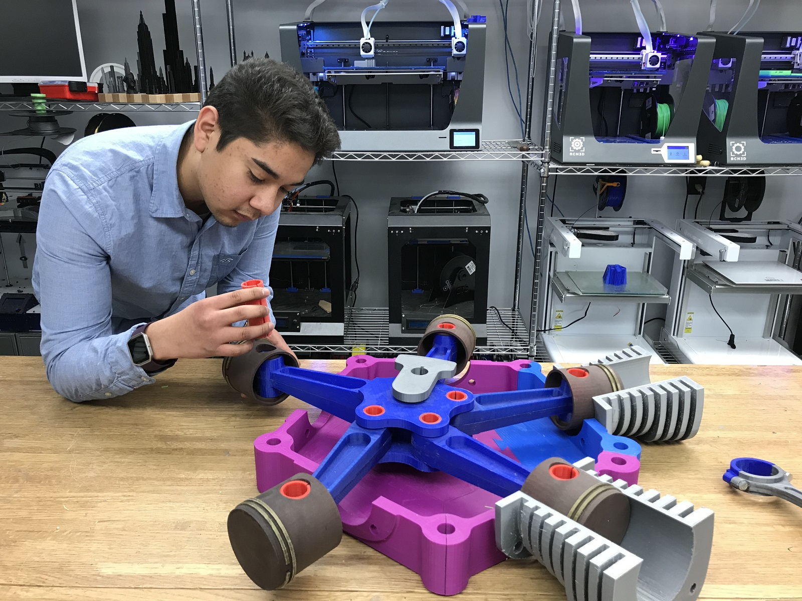
University of West Alabama
3b. Bachelor of Science in Mechanical Engineering Technology (CIP 15.0805)
The proposed BS in Mechanical Engineering Technology will provide a more specialized curriculum than current BS in Engineering Technology (CIP 15.0000) in response to industry need.
The proposed program will utilize existing faculty and resources within UWA’s Division of Engineering and Technology to reduce start-up costs.
The proposal is accompanied by fourteen letters of support from UWA’s Industrial Advisory Board members, who represent potential employers.

Slide 78
Motion, Decision Item B-3b:
That the Commission approve University of West Alabama’s proposal to offer a Bachelor of Science in Mechanical Engineering Technology.

Slide 79
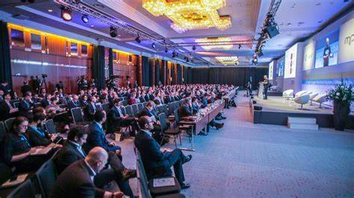
University of West Alabama
3c. Bachelor of Arts and Bachelor of Science in Creative Arts Enterprise
(CIP 50.1001)
The proposed program will consolidate existing degree offerings in Interdisciplinary Arts (CIP 30.0000) and Music (CIP 50.0901) and will not require any additional resources to implement.
The proposal includes letters of recommendation from the Alabama State Council on the Arts and Black Belt Treasures Cultural Arts Center.

Slide 80
Motion, Decision Item B-3c:
That the Commission approve University of West Alabama’s proposal to offer a Bachelor of Arts and Bachelor of Science in Creative Arts Enterprise.

Slide 81
ALABAMA COMMUNITY COLLEGE SYSTEM

Slide 82
Lurleen B. Wallace Community College
4. Associate of Applied Science in Welding (CIP 48.0508)
The proposed AAS in Welding is designed to prepare graduates for employment in occupations on the Statewide In-Demand Occupations List, such as welders, cutters, solderers, and brazers.
The proposed degree will build on the existing certificate and short-term certificates offered by the College and require no new funds to implement.

Slide 83
Motion, Decision Item B-4:
That the Commission approve Lurleen B. Wallace Community College’s proposal to offer an Associate of Applied Science in Welding.

Slide 84
Northeast Alabama Community College
5. Associate of Applied Science in Dental Hygienist (CIP 51.0602)
The proposed AAS in Dental Hygienist is designed to prepare graduates for state licensure and employment as Dental Hygienists, which are included on the Statewide Demand Occupations List.
This proposal includes six letters of support from local industry partners and future employers attesting to the need for this program.

Slide 85
Motion, Decision Item B-5:
That the Commission approve Northeast Alabama Community College’s proposal to offer an Associate of Applied Science in Dental Hygienist.

Slide 86
C. Information Items
Implementation of Non-Degree Programs at Senior Institutions
Implementation of New Short Certificate Programs (Less than 30 Semester Hours)
Changes to the Academic Program Inventory
Updates to Academic Units
Extensions/Alterations to Existing Programs of Instruction

Slide 87
C. Information Items
Implementation of Distance Education Programs
New Exempt Off-Campus Site—University of Alabama in Huntsville
New Exempt Off-Campus Site—University of North Alabama
New Exempt Off-Campus Site—Wallace Community College- Selma
Summary of Post-Implementation Reports

Slide 88
7a. Summary of Post-Implementation Reports
Programs that Met Post-Implementation Conditions
Two-Year Institutions
Drake State Community and Technical College, Associate of Applied Science and Certificate in Culinary Arts (CIP 12.0503)
Enterprise State Community College, Associate of Applied Science and Certificate in Medical Assistant Technology (CIP 51.0801)
Shelton State Community College, Associate of Applied Science in Welding Technology (CIP 48.0508)
Trenholm State Community College, Associate of Applied Science and Certificate in Business Administration (CIP 52.0201)
Wallace Community College- Selma, Associate of Applied Science and Certificate in Industrial Maintenance Technology (CIP 47.0303)

Slide 89
7a. Summary of Post-Implementation Reports
Programs that Met Post-Implementation Conditions
Four-Year Institutions
Auburn University, Doctor of Philosophy in Earth System Science (CIP 40.0699)
Troy University, Bachelor of Science in Cyber Security (CIP 11.1003)
Troy University, Master of Arts in Economics (CIP 52.0601)

Slide 90
7b. Summary of Post-Implementation Reports
Programs that Did Not Meet Post-Implementation Conditions
Recommended for Closure
Four-Year Institutions
Alabama A&M University, Bachelor of Science in Plant Biotechnology (CIP 26.1201)
Auburn University at Montgomery, Master of Science in Geographic Information Systems (CIP 45.0702)
Troy University, Bachelor of Science in Physics (CIP 40.0801)

Slide 91
Motion, Decision Item C:
That the Commission accept the Information Items as presented.

Slide 92
D. ADJOURNMENT

