Slide 1
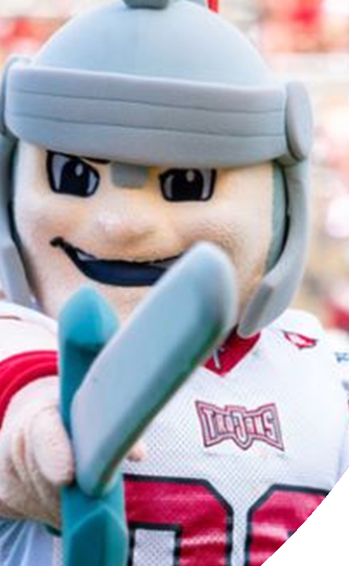
RECRUITING TROJANS
Tamara Broadnax
Brian Belarmino
Coordinator of State Authorization
Troy University
Enrollment Coordinator
Troy University

Slide 2
TROY UNIVERSITY
Online Enrollment
Online Programs
Support Sites
6,000+
100+
5+

Slide 3
Enrollment Management
Structure
Enrollment
Coordinator
Admission
Specialist
Recruiter

Slide 4
Recruiter Characteristics

Slide 5
Common Practices
3 THING TO KNOW
Prospective
student
School
history
Recruiting
area

Slide 6
Recruiting Tips
SMALL EVENTS
QR CODES
PARTNERSHIPS

Slide 7
Challenges
I don’t have time to talk.
I’ve never heard of
Troy University.

Slide 8
"One important key to success is self-confidence. An important key to self-confidence is preparation"
Arthur Ashe

Slide 9
Questions?
Brian Belarmino
bbelarmino@troy.edu
Tamara Broadnax
tgreen83329@troy.edu

