Slide 1
Federal Update Professional Licensure, Distance Education, Third-Party Servicers & Impact of Recent Supreme Court Decisions
November 22, 2024
Alabama SARA Workshop
Columbia Southern University

Slide 2
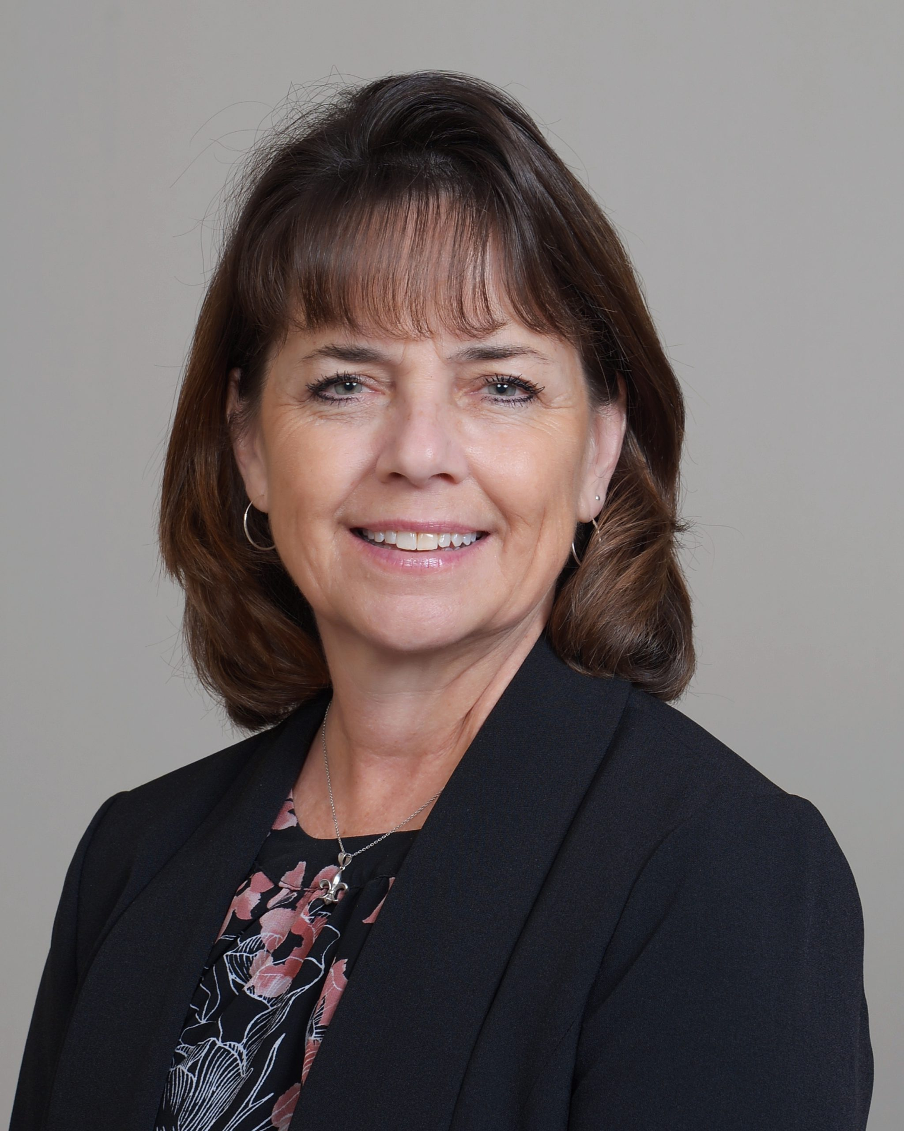
Meet the SAN Team
Cheryl Dowd
Senior Director,
State Authorization Network & WCET Policy Innovations
Leigha Fletcher
Administrative Assistant
Kathryn Kerensky Director, Digital Learning
Policy & Compliance
Jana Walser-Smith Director, Interstate Compliance & SAN Member Outreach

Slide 3
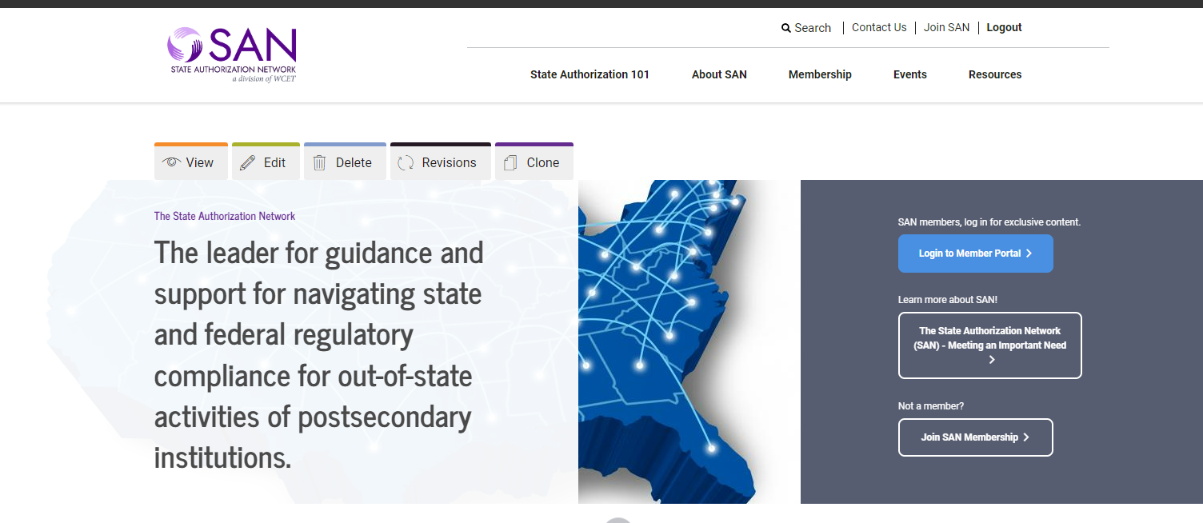
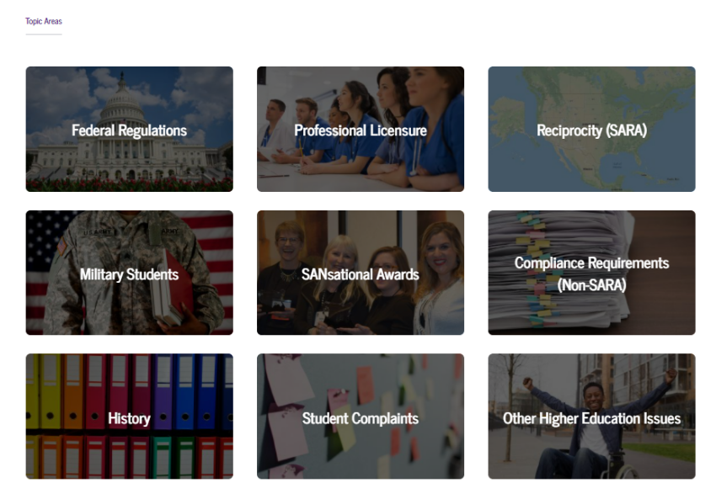
Who we are
The State Authorization Network (SAN) empowers its members to successfully resolve postsecondary regulatory compliance challenges.
We provide expert analysis, resources and training to prepare for emerging issues, collaborate on compliance strategies, develop solutions and evaluate their efficacy.
Our members are digital learning and compliance professionals representing 800+ institutions and organizations nationally and across all sectors.
wcetsan.wiche.edu
Notes:
Add note to this slide

Slide 4
Level Setting Federal Rules & Rulemaking

Slide 5
Whose Rules? State vs Federal
State Authorization Network
STATE
FEDERAL
Compliance in one bucket could reference compliance in the other bucket.
Examples:
Department of Education – Title IV
State Institutional Approval + Location
Prof. Licensure Programs
“Satisfy” State Educ. Requirements
Disclosures
Other Title IV Rules
Distance Ed, Accreditation, TPS
Department of Justice
New Accessibility Regulations
Examples:
State Institutional Approval
Interstate Distance Education
Individual State or Reciprocity (SARA)
State Program Approval
Interstate Prof. Licensure Programs
State Employment Law Related
For Faculty, Staff, Experiential Learning, Business related issues.

Slide 6
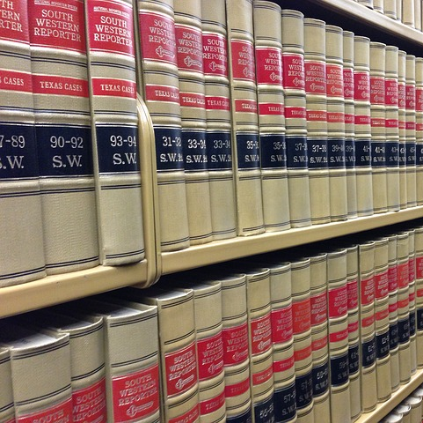
Federal Statutes, Regulations, & Guidance
State Authorization Network
Federal Statutes - laws developed by Congress, typically with approval of the President.
Federal Regulations - rules developed by the Executive departments and agencies.
To implement federal laws. (within the authority of the federal laws)
Regulations have the force and effect of law and are therefore legally binding.
Guidance - represents ED’s current thinking on a topic.
Does not create or impose any requirements beyond those required under applicable law and regulations.
Lacks the force and effect of law.

Slide 7
Rulemaking Process (Federal Regs)
State Authorization Network
Governed by the Administrative Procedure Act (APA) (5 U.S.C. Chapter 5)
MANY MANY STEPS!!!
Notice of Intent to Establish a Negotiated Rulemaking; subject to public comment.
Call for Nominations of Stakeholders to Address the Established Issues for Rulemaking Committee.
Convening of Negotiated Rulemaking Committee
Negotiate the issues
Goal – Consensus
Department Prepares Proposed Rules
Issues reaching consensus generally become the proposed rules.
Issues not reaching consensus may be written by the Department.
Department submits regulations to Office of Management & Budget (OMB) for review.
Release of Notice of Proposed Rulemaking (NPRM); subject to public comment.
Department must review all comments, prepare responses, and prepare final regulations.
Department submits regulations to Office of Management & Budget (OMB) for review – AGAIN!
Department releases final regulations with responses to public comments (preamble).

Slide 8
Strict Timeline
State Authorization Network
Master Calendar for
U.S. Department of Education Title IV Regulations
Dates to Support Financial Aid Year
Final Regulations must be released by November 1 to be effective the following July 1.l

Slide 9
ED Rulemaking in Action
State Authorization Network
Rulemaking 2021-2022
Final Rules Effective July 1, 2024
Final Regulations for Financial Value Transparency & Gainful Employment
Financial Responsibility, Administrative Capability, Certification Procedures, Ability to Benefit (ATB).
Rulemaking 2023-2024
Program Integrity and Institutional Quality
Cash Management, State Authorization, Distance Education, Return to Title IV(R2T4), Accreditation, TRIO Programs
July 17, 2024 - Update on Department of Education's Postsecondary Education Regulatory Work - ED blog post, by James Kvaal, US Under Secretary of Education. The post shares the timeline for future proposed rules and to expect another rulemaking to address Third-Party Servicers.

Slide 10
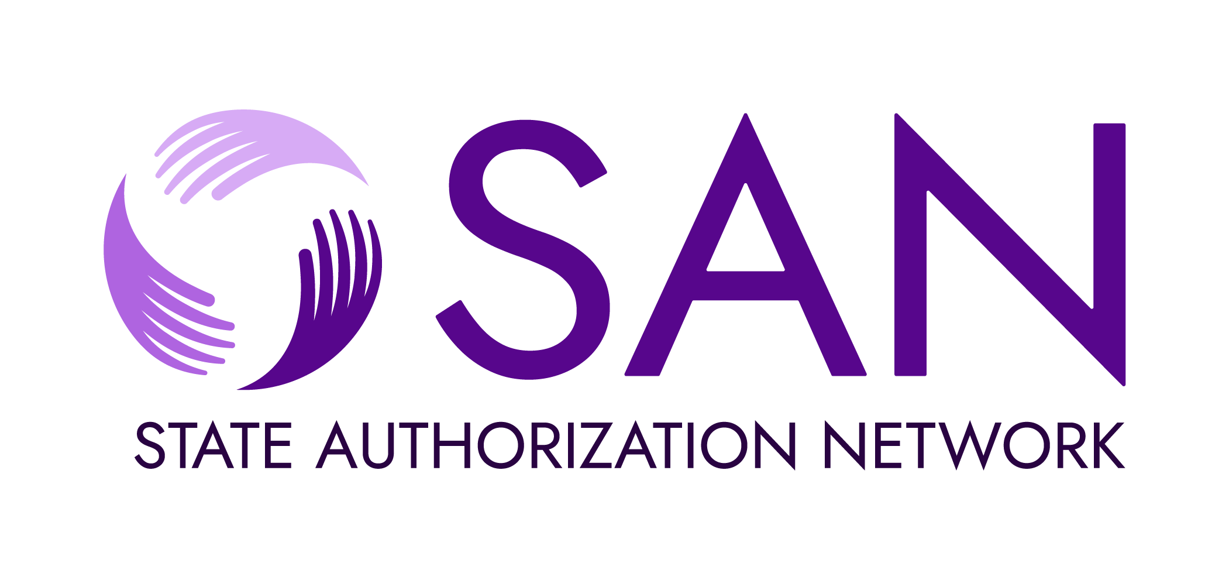
New Regulations Effective July 1, 2024 Certification Procedures

Slide 11
Certification Procedures – 34 CFR 668.13 & 668.14
Program Participation Agreement (PPA)
State Authorization Network
PPA is an agreement between postsecondary institutions and the U.S. Department of Education.
The institution certifies compliance with specific obligations in order to participate in Title IV HEA Programs.
The Department’s goal was to strengthen the student protections within the PPA.
The sub-issues for which we followed were among the new requirements being added to the PPA.

Slide 12
Related to Professional Licenses & Certification –
PPA Certification
State Authorization Network
34 CFR 668.14(b)(32)(ii)
Raised the Bar When Offering Programs Leading to a License
For the program to be eligible for Title IV – the institution must satisfy state educational requirements
Where the institution is located.
Where the student enrolled in distance education
On or after July 1, 2024.
Is located at the initial time of enrollment.
OR
Where the student attests that they intend to seek employment.

Slide 13
Notifications
State Authorization Network
34 CFR 668.43(a)(v) and (c)
Minor changes since these became effective July 1, 2020.
Public notifications – institution determinations of whether the curriculum meets or does not meet various state educational requirements where students are served.
Direct/individualized notification for:
Prospective students to inform if the program does not meet or if the institution has not made a determination.
Enrolled student to inform if the program no longer meets state educational requirements. Within 14 calendar days of the institution making that determination.

Slide 14
Responsibilities of the Institution
State Authorization Network
Revise or develop the institution’s location policy. (required in Federal regulation since July 1, 2020)
Research state educational requirements where students are served by the institution.
Compare & determine if the curriculum satisfies the educational requirements.
Carefully consider the use of attestation. (not for everyone and documentation is necessary)
Continue to follow a process to provide public and direct notifications.
Communicate with senior administration and general counsel
to make business decisions about institutional priorities
to serve certain states and certain professions.

Slide 15
U.S. Department of ED - Announcement
State Authorization Network
April 9, 2024
(GE-24-03) Updates on New Regulatory Provisions Related to Certification Procedures and Ability-to-Benefit
U.S. Department of Education announcement offers some limited circumstance compliance extension over new PPA professional licensure regulations through January 1, 2025.
Read carefully and document.

Slide 16
U.S. Department of Education
Dear Colleague Letter (DCL)
State Authorization Network
May 16, 2024
(GEN-24-07) Implementation of Regulations Related to Financial Responsibility, Administrative Capability, Certification Procedures, and Ability to Benefit (ATB) (Updated August 23, 2024)
U.S. Department of Education DCL provided a summary of changes and offers links on the Office of Postsecondary Education website.
Includes: Certification Procedures Regulations Questions & Answers
*August 23, 2024, update puts 668.14(b)(26) new Maximum Rule on hold.

Slide 17
Negotiated Rulemaking Winter 2024
Negotiated Rulemaking for Higher Education 2023-24
Program Integrity and Institutional Quality
DID NOT REACH CONSENSUS!
*except TRIO

Slide 18
Rulemaking Issues
State Authorization Network
Cash Management
State Authorization
Distance Education
Return to Title IV (R2T4)
Accreditation
TRIO Programs *addressed by subcommittee

Slide 19
Notice of Proposed Rulemaking (NPRM)
Released 7/24/24
Program Integrity and Institutional Quality: Distance Education, Return of Title IV, HEA Funds, and Federal TRIO Programs
State Authorization Network
Distance Education
Return to Title IV (R2T4)
TRIO Programs

Slide 20
Distance Education: Disallow Asynchronous Distance Education Courses for Clock Hour Programs
For institutions using the “clock hour” method of financial aid disbursement, they can no longer use asynchronous courses. Note that this has no impact on institutions that use the credit hour for financial aid purposes.

Slide 21
Distance Education: Define Distance Education Course
It is a course in which instruction takes place exclusively at a distance “notwithstanding in-person non-instructional requirements, including orientation, testing, academic support services, or residency experiences.”

Slide 22
Distance Education: Virtual Location
All students are currently assigned to a main campus, branch campus, or additional location. Propose:
Create new subset of additional location: a "virtual location."
Assign students there who are enrolled in programs that are: “…100 percent of an educational program through distance education or correspondence courses, not withstanding requirements for students to complete on-campus or residential periods of 90 days or less."
Main, branch, additional definitions: https://www.ecfr.gov/current/title-34/subtitle-B/chapter-VI/part-600/subpart-A/section-600.2

Slide 23
Return to Title IV: Attendance Taking
Require "attendance" taking for ALL distance education courses:
Logins don’t count.
Document every instance of “academic engagement,” such as take a test, submit a paper, or participate in discussion on course content.
Document student's withdrawal within 14 days of "last date of attendance."
Notes:
If a student does not have a documented absence or has not performed an “academic engagement” activity in 14 days, the institution must “document a student’s withdrawal date.”

Slide 24
Review of Rulemaking Committee Reciprocity Proposal – No Consensus
No proposed rules have been released on this issue
Limit of 500 students
enrolled by a reciprocity-participating institution in a state
for two consecutive years for the institution to maintain state authorization through reciprocity.
More than 500 enrolled students would require individual state authorization for that state
Enforcement of certain state-specific laws
regardless of participation in reciprocity.
Institutions are subject to applicable general-purpose state laws. (those enforceable on any business).
State laws related to closure, if any in a state.
Complaint process requirements
Permit students to complain directly to the state agency without first seeking resolution at the institution if permitted by state statutes and regulations. •
Oversight Board Governance Structure
Limit the reciprocity agreement’s governing board to only employees who enforce state laws.
Notes:
Explain the ED goal of more rigor for consumer protection when using reciprocity agreements

Slide 25
What happened to the Third Party-Servicers (TPS) issue?
State Authorization Network
TPS was originally listed in the Notice of Intent to Establish a Rulemaking for the 2023-2024 rulemaking.
ED intended to put in regulation rules as referenced in the 2023 Third Party Servicer Guidance and Request for Information addressing the 2011 Bundled Services Exception Guidance for OPMs.
Under Secretary James Kvaal indicated in the July 2024 blog post that there would still be rulemaking in the future to address TPS.
Formal recission of the 2023 Guidance by November 18, 2024.
Discussions prior to the election included the possibility that we would see a revision to the 2011 Bundled Services Exception Guidance.

Slide 26
U.S. Supreme Court Opinions

Slide 27
Judicial Review of Regulations
State Authorization Network
Loper Bright Enterprises & Raimondo and Relentless Inc. v. Department of Commerce.
Overturned the Chevron Doctrine - agency interpretation deference to determine statutory authority if the Federal statute is ambiguous or silent.
Corner Post, Inc. v Board of Governors of the Federal Reserve System
Directs that the 6-year statute of limitations for a legal challenge against the U.S. begins when the party (the plaintiff) is injured not when the regulation became final.
Take away – No regulations were immediately struck down. The rules are the rules until they are not. However, look for an increase in regulatory challenges in the near and long-term future and perhaps more focus on agency authority in the development of future regulations!
Notes:
Struck Down - SOL party injured

Slide 28
So, What’s Next?
This Photo by Unknown Author is licensed under CC BY-SA

Slide 29
Impact of the Election & Recent Supreme Court Opinions
Final Title IV rules released after November 1, 2024, will not be effective until July 1, 2026.
The next administration has no responsibility to follow further steps on rules not released as final.
There may be court challenges to currently effective rules.
Effective rules remain the rules until they are vacated.
Watch carefully to determine if the effective rules are subject to a temporary hold.
This Photo by Unknown Author is licensed under CC BY-SA
Notes:
Van

Slide 30
Resources

Slide 31
Resources
SAN Website:
SAN Getting Started with Compliance Management Gateway: https://wcetsan.wiche.edu/resources/getting-started
SAN Federal Regulations Landing Page: https://wcetsan.wiche.edu/resources/federal-regulations
SAN Professional Licensure Landing Page: https://wcetsan.wiche.edu/resources/professional-licensure
Professional Licensure Handbook 2nd edition (2024)
WCET Frontiers (Articles)
Ready or Not, Here It Comes! New Regulations When Offering Programs Leading to a License Effective July 1! WCET Frontiers, 7/9/24
Recent Supreme Court Decisions: Chevron, Loper Bright, and Corner Post… What Are These and How Do They Affect Distance Education? WCET Frontiers; 7/18/24
Buckle up. ED is Off to the Races With Its NPRM; WCET Frontiers; 7/22/24
What Might Happen to the Department’s Pending Regulations and Guidance?; WCET Frontiers; 11/14/24

Slide 32
Your Questions?

Slide 33
Thank you!
Contact Us!
Cheryl Dowd, Senior Director, State Authorization Network & WCET Policy Innovations
(303) 541-0210 | cdowd@wiche.edu
Kathryn Kerensky, Director, Digital Learning Policy & Compliance
(303) 541-0290 | kkerensky@wiche.edu
Jana Walser-Smith, Director Interstate Compliance & SAN Member Outreach
(303) 541-0289 | jwalsersmith@wiche.edu
Leigha Fletcher, Administrative Assistance
(303) 541-0211 | lfletcher@wiche.edu
3035 Center Green Drive
Suite 200
Boulder, CO 80301
Email us at: san-info@wiche.edu
wcetsan.wiche.edu

